Slide 1
Heart to Heart
Patient care and You
Ashley D. Gilmore,
MS.ED, MFT, LCMHC, NCC
Gilmore Counseling &
Consulting Services, PLLC
Durham, NC
August 19, 2021
Indiana Society of Cardiac and Pulmonary Rehabilitation

Slide 2
Our time together…
Who is Ashley?
Mental health
Self care
Ways to manage Anxiety and Depression
Example
Tips and resources
Closing Exercise

Slide 3
What is Mental Health?
What is your idea of mental health?
What DO you believe about mental health in your own life? What about your job?
How has COVID-19 impacted your mental health and your work?
Notes:
According to the World Health Organization- mental health is "a state of well-being in which the individual realizes his or her own abilities, can cope with the normal stresses of life, can work productively and fruitfully, and is able to make a contribution to his or her community.
<number>

Slide 4
Mental Health in the Workplace
When a patient receives a diagnosis, what do you feel?
A 2020 article writes that health care professionals believe anxiety can be decreased by 5 things, related to their patients:
Hear me
Protect me
Prepare me
Support me
Care for me
Notes:
What impact does a patient’s diagnosis and their behavior have on you?
Health care professionals that included nurses, physicians, specialists, rehab technicians and others.
Another study showed that 93% of health workers were experiencing stress related to their jobs, 86% experienced anxiety and depression was not indicated on the scale.
Health care professional believe the pandemic has heightened emotional barriers in the field and while some have stayed, many have left.
<number>

Slide 5
Patient Care & You
Emotional Support
Empathy
Detachment
Notes:
A 2016 study found that healthcare professionals experience emotional traumas such as anger, fear, loneliness on a daily basis. And because of this, you develop a sense of ‘true empathy.’
But what happens when it happens with every single patient? Imagine the patient who has just been diagnosed with Congestive Heart Failure or Emphysema. And what would you say to them? How would you show up for them in a way that makes them feel supported?
Research shows that around 40% of patients have some symptoms of depression and 85% of patients are more likely to develop anxiety after a pulmonary or cardiac diagnosis.
<number>

Slide 6
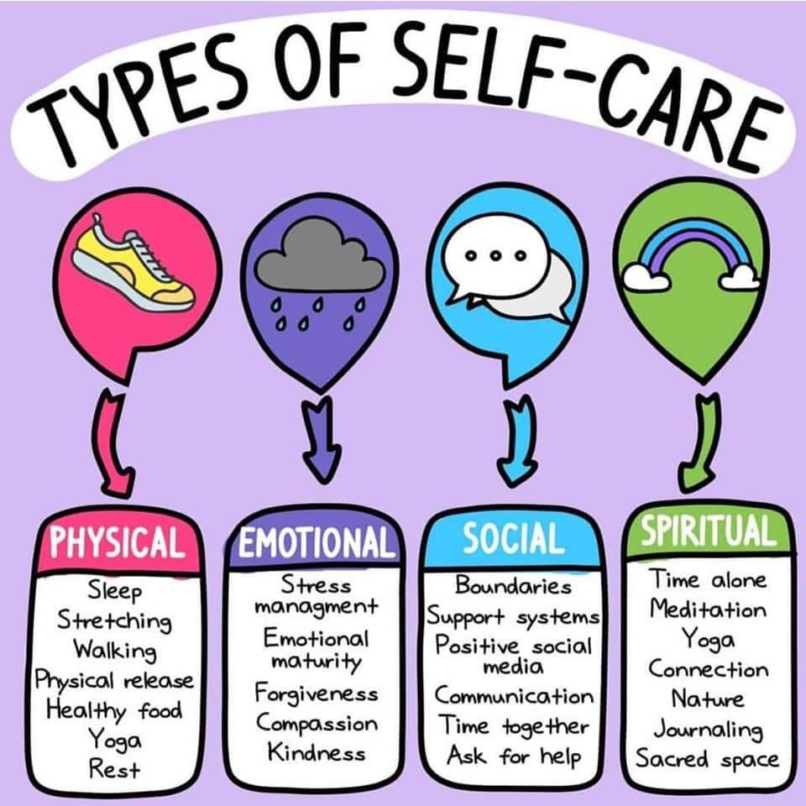
Self-Care
How would you define self care?
Self care is an emergency response
Self care is a privilege
Self care is easy
Self care is about going away or spending money
Notes:
Self-care is the practice of taking an active role in protecting one's own well-being and happiness, in particular during periods of stress.
How do we get the patients to care for themselves?
Self care should be wholistic… physically, spiritually, psychologically/emotionally
Additionally, self care is seen as a much more modern approach to healing.. I’m sure when my grandmother was alive, the idea of me taking a mental health day or doing yoga for mental wellness, would have been almost laughed
<number>

Slide 7
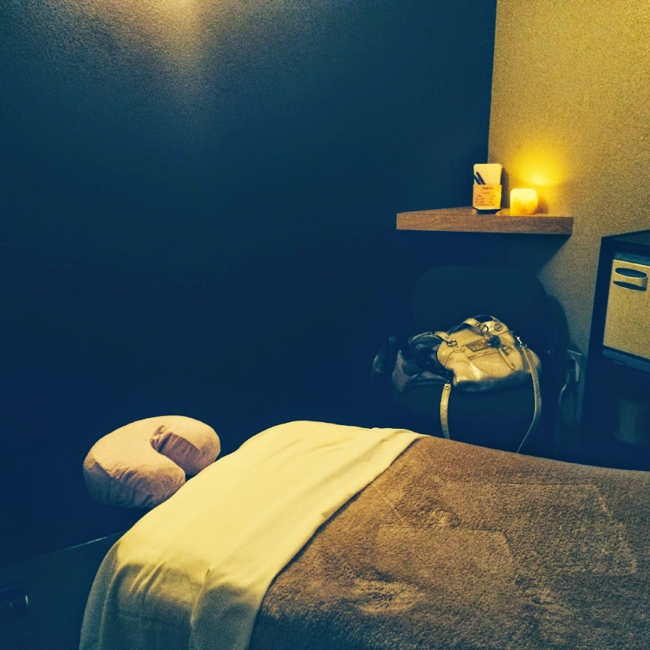
Myths of Self Care
What people think self care is.
What self care can be.
Notes:
And self care can be both! They are not mutally exclusive. One costs, one doesn’t. Both are good for your body.
<number>

Slide 8
Healthy ways to Manage Anxiety & Depression
Healthy eating
Water
Less sugary drinks
More green leafy vegetables/protein
Exercise daily
30 minutes a day
Get enough sleep
Breathing and meditation
4-6-8
Therapy
Notes:
Journaling and meditation are helpful ways to manage anxiety and stress. Writing affirmations has been shown to improve mental capacities at work and at home.
Limit alcohol and increase time with loved ones.
<number>

Slide 9
Let’s Practice
Clarence is a 57 year-old African American male, who has been diagnosed with copd. Clarence has been married for 25 years and has enjoyed an active sex life with his wife. Clarence has been prescribed Spiriva Respimat. And while the RX is helpful for breathing, clarence is struggling with erectile dysfunction and causing him some mild depression.
What do you do?

Slide 10
Anxiety and Depression Association of America
National Institute of Mental Health
American Counseling Association
IU School of Medicine Department of Psychiatry
Apps for your Mobile Device
Calm
Insight Timer
Tips & Resources

Slide 11
Closing Exercise
3 Things you’re grateful for.
What will you do this weekend to care for yourself?
“The Love of the family, the love of one person can heal.
It heals the scars left by a larger society.”
Dr. Maya Angelou

