Slide 1
ISCVPR 2023
Bronchoscopic Lung Volume Reduction (BLVR)
Christopher Kniese MD, MPH
Assistant Professor of Clinical Medicine

Slide 2
Objectives
Review pathophysiology of hyperinflation in severe emphysema
Discuss endobronchial valves, review mechanism of action and inclusion criteria
Discuss outcomes of bronchoscopic lung volume reduction including most recent literature

Slide 3
Disclosures
Consulting work for Cook Medical unrelated to current topic

Slide 4
Objectives
Review pathophysiology of hyperinflation in severe emphysema
Discuss endobronchial valves, review mechanism of action, and inclusion criteria
Discuss outcomes of bronchoscopic lung volume reduction including most recent literature

Slide 5
Chronic Obstructive Pulmonary Disease (COPD
COPD
Chronic Obstructive Asthma
Chronic Bronchitis
Emphysema

Slide 6
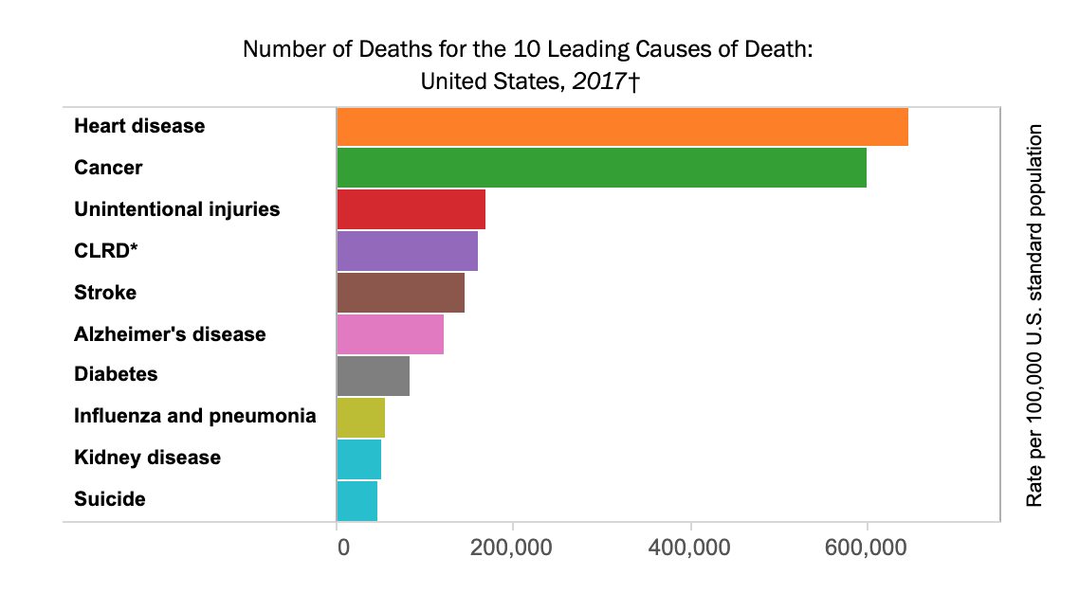
Tejada-Vera, et al. 2019

Slide 7
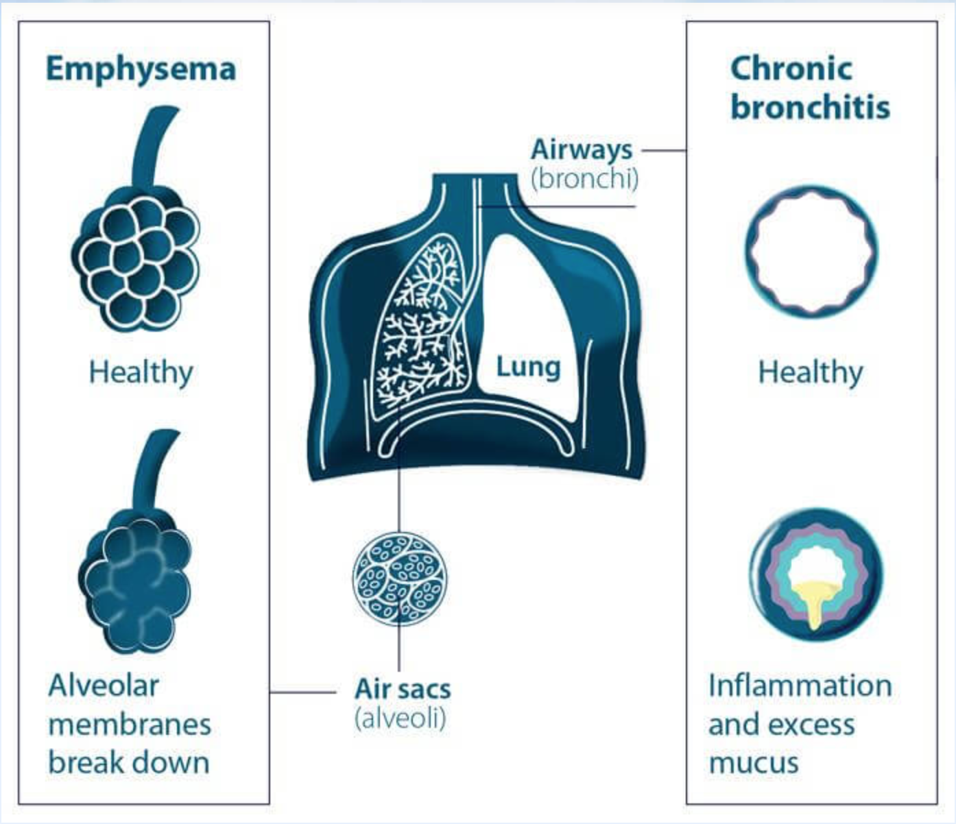
British Lung Foundation. 2020

Slide 8
Hyperinflation in COPD
Normal lungs rely on elastic recoil to aid in the respiratory cycle
Lung elasticity is reduced in patients with lung damage due to emphysema, leading to impaired exhalation
Patients see increases in both static (at rest) and dynamic (with exercise) hyperinflation

Slide 9
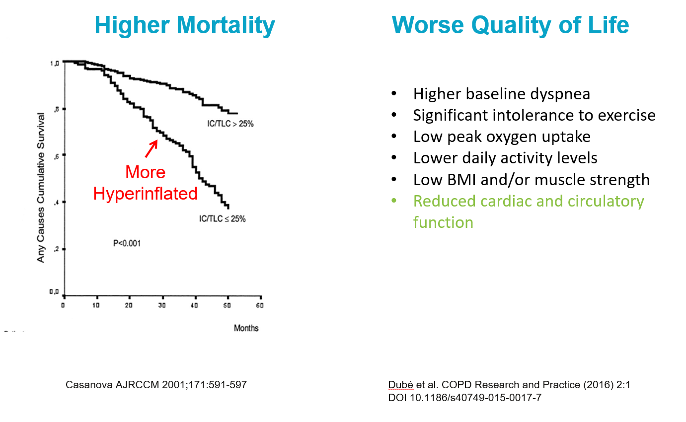
Hyperinflation is a key driver of symptoms and mortality

Slide 10
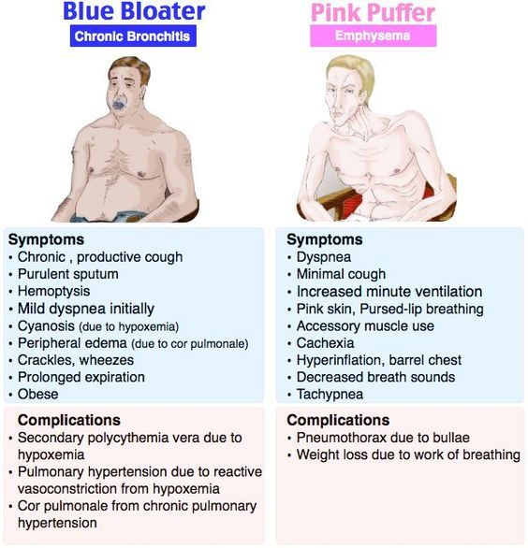

Slide 11
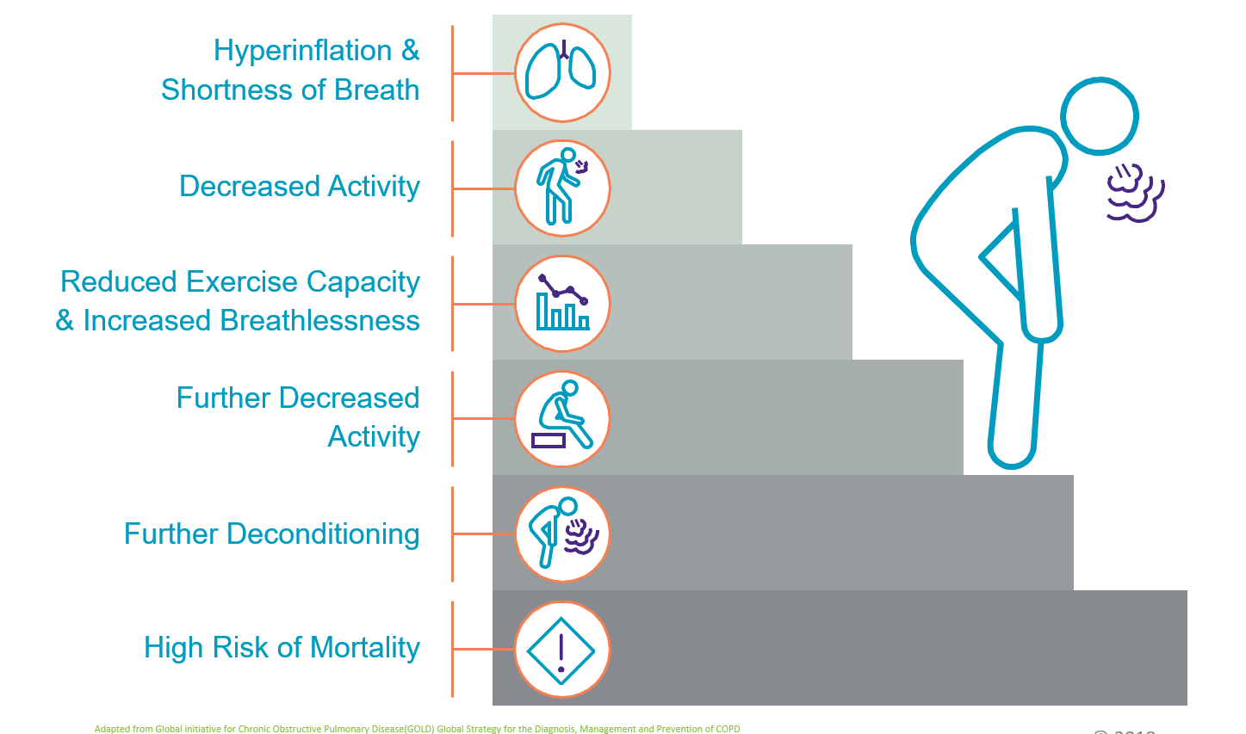
Disease Progression

Slide 12
Pharmacologic treatments of hyperinflation
Long-acting beta-agonist (LABA) associated with increased exercise tolerance and reduction in dynamic hyperinflation
Long-acting muscarinic antagonist (LAMA) associated with increased inspiratory capacity (IC), decreased functional residual capacity (FRC), and increased exercise time
Inhaled corticosteroid (ICS)/LABA combination increases inspiratory capacity and exercise capacity

Slide 13




Spectrum of Treatment Options
| <number>
Medical Management
Pulmonary Rehabilitation
Lung Volume Reduction Surgery
Lung Transplant
Non Invasive
Invasive
© 2018 Pulmonx Corporation

Slide 14
Objectives
Review pathophysiology of hyperinflation in severe emphysema
Discuss endobronchial valves, review mechanism of action and inclusion criteria
Discuss outcomes of bronchoscopic lung volume reduction including most recent literature

Slide 15
Bronchoscopic Lung Volume Reduction (BLVR)

Slide 16


The Zephyr® Endobronchial Valve
“Breakthrough Technology” Approved by the FDA for Severe Emphysema Patients
Tiny implantable devices
Benefits similar to surgery with no cutting
Precise patient selection
Proven in clinical trials and included in guidelines
Fully removable
© 2018 Pulmonx Corporation

Slide 17

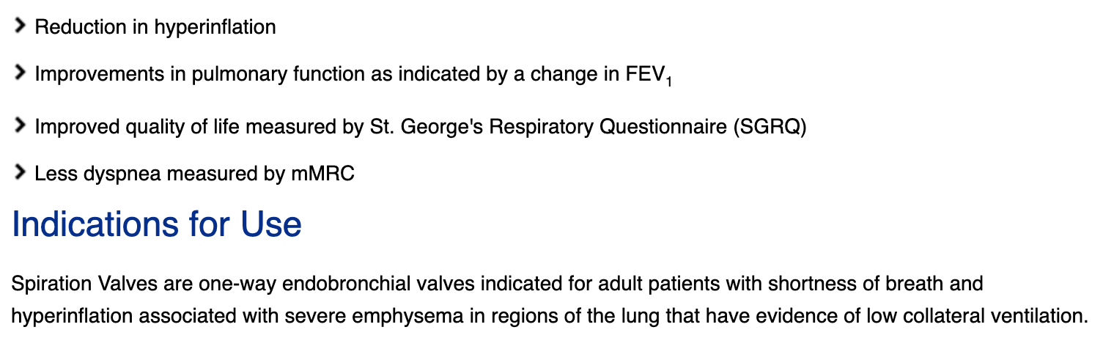
Spiration
Valve system
Olympus Corporation

Slide 18
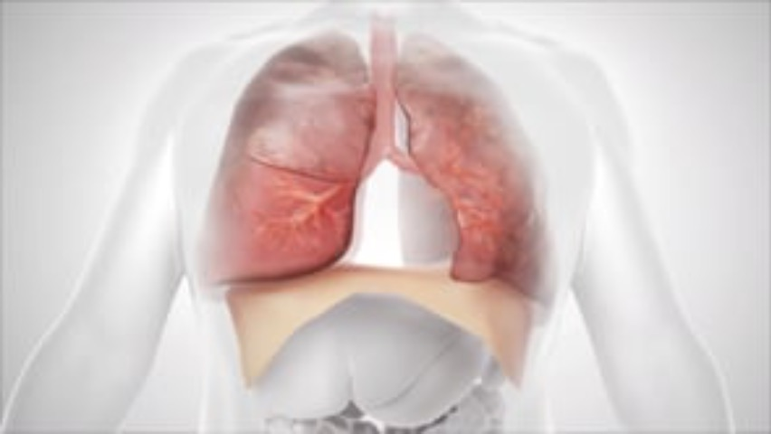

Slide 19
Bronchoscopic Lung Volume Reduction (BLVR)
One-way valves implanted bronchoscopically into target lobe in order to achieve lobar atelectasis and reduce hyperinflation
Minimally invasive approach, procedure can be performed using either moderate sedation or general anesthesia
Goal is similar to LVRS without requiring surgical removal of lung tissue

Slide 20
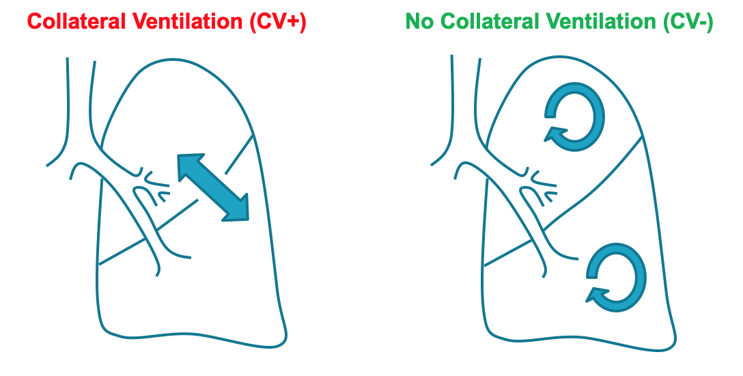
Fissure Integrity and Collateral Ventilation (CV)
Important to ensure there is not CV between target lobe and ipsilateral lobe or else valves will not work
Cetti, et al. 2006

Slide 21
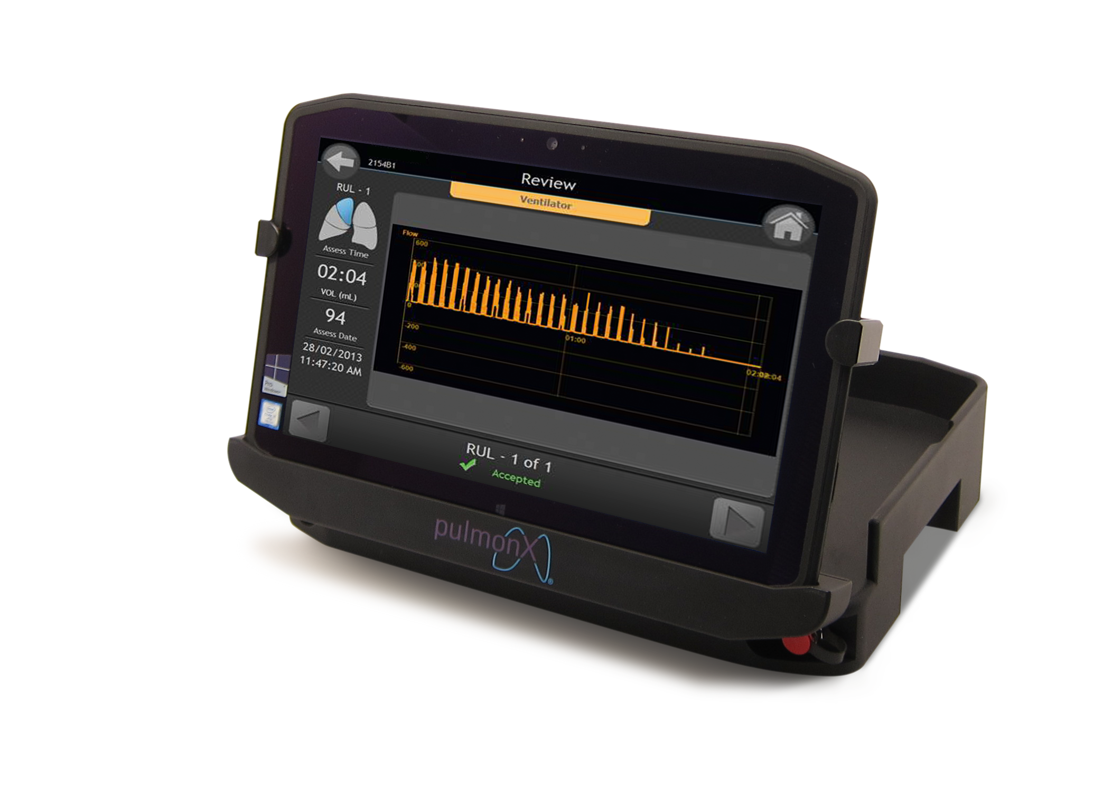
CV Assessment
Fissure integrity is assessed by the combination of high-resolution CT scan and direct assessment during bronchoscopy
Chartis balloon system (Pulmonx Corporation) is FDA-approved for assessment of collateral ventilation during bronchoscopy
© 2018 Pulmonx Corporation

Slide 22
Initial Assessment and Work-up
Medical history
  Diagnosis of emphysema
  BMI < 35 kg/m²
  Stable with ≤ 20mg prednisone (or equivalent) daily
  Non-smoking
  Collect any available imaging and lung function studies
Pulmonary Function Tests (post-bronchodilator)
  Spirometry (FEV₁ 15-45% predicted)
  Body Plethysmography (RV ≥ 175%, TLC ≥ 100%)
Arterial Blood Gas Levels collected on room air
  Rule out severe hypercapnia PaCO2 ≥50 mm Hg
  Rule out severe hypoxemia PaO2 ≤45 mm Hg
6MWD (100m-500m)
Imaging
  High Resolution CT (≤ 1.5mm slice thickness, TLC view)
  Upload to StratX
  Perfusion Scan (Optional)
Echocardiogram
  Rule out congestive heart failure, LVEF <45%
  Rule out uncontrolled pulmonary hypertension, sPAP >45mm Hg

Slide 23
Indiana University AHC BLVR Criteria
Inclusion Criteria:
Age > 40yrs
FEV₁ < 45%
TLC >100%
DLCO > 20%
RV >175%
6 MWT >150 m, < 450 m
Prior pulmonary rehab
Maximal medical therapy
CT Criteria:
- Severe emphysema defined as target lobe with ≥40% emphysema involvement
- High heterogeneity defined as ≥10 point disease severity difference with the ipsilateral lobe (for Spiration valves; this is not needed for PulmonX)
- Fissure integrity defined as ≥90% completeness of the fissure(s) separating the target lobe (80% if using PulmonX system with Chartis)

Slide 24
Indiana University AHC BLVR Criteria
Exclusion Criteria:
- Pulmonary HTN (RVSP >45mm)
- BMI > 35
- Inability to tolerate flexible bronchoscopy procedures
- Known or suspected sensitivity or allergy to nickel
- Evidence of active pulmonary infection
- Known allergies to silicone
- Current smoker
- Large bullae encompassing greater than 30% of either lung
- Exacerbations of COPD in 6-8 weeks
- Evidence of strong collateral ventilation in target lobe via Chartis system (only applies to PulmonX valves)
- Asthma/COPD overlap syndrome, or significant bronchodilator response

Slide 25
Procedure Details
Performed in endoscopy suite or OR, depending on hospital protocol
Single lobe is selected for treatment:
  RUL, RLL, LUL, LLL
Generally takes ~ 1 hour
Patients are admitted to the hospital for monitoring after valve placement, and remain in the hospital for at least 3 nights after the procedure

Slide 26
Procedure Details
Procedure can be performed either with moderate sedation or general anesthesia*
If under general anesthesia, either endotracheal intubation or laryngeal mask airway can be used
Some centers use paralysis to aid in valve placement

Slide 27
Anesthetic Approach
Little data to guide us here
Theoretical approach using lower inhaled oxygen concentration during anesthesia to reduce nitrogen washout and prevent rapid atelectasis
Choice of anesthetic up to Anesthesiology team in conjunction with proceduralist

Slide 28
Post-Procedure Considerations
Once released from hospital, patients are under no specific physical restrictions
Encouraged to resume pulmonary rehab following hospital discharge in hopes of maximizing benefit
No additional monitoring required

Slide 29
Patient Case
Deb, 65 year old female diagnosed with COPD 5 years ago, quit smoking 15 years ago
Previously active, now short of breath doing ADLs
On standard triple therapy for advanced COPD
Has completed pulmonary rehab twice
Poor quality of life due to dyspnea

Slide 30
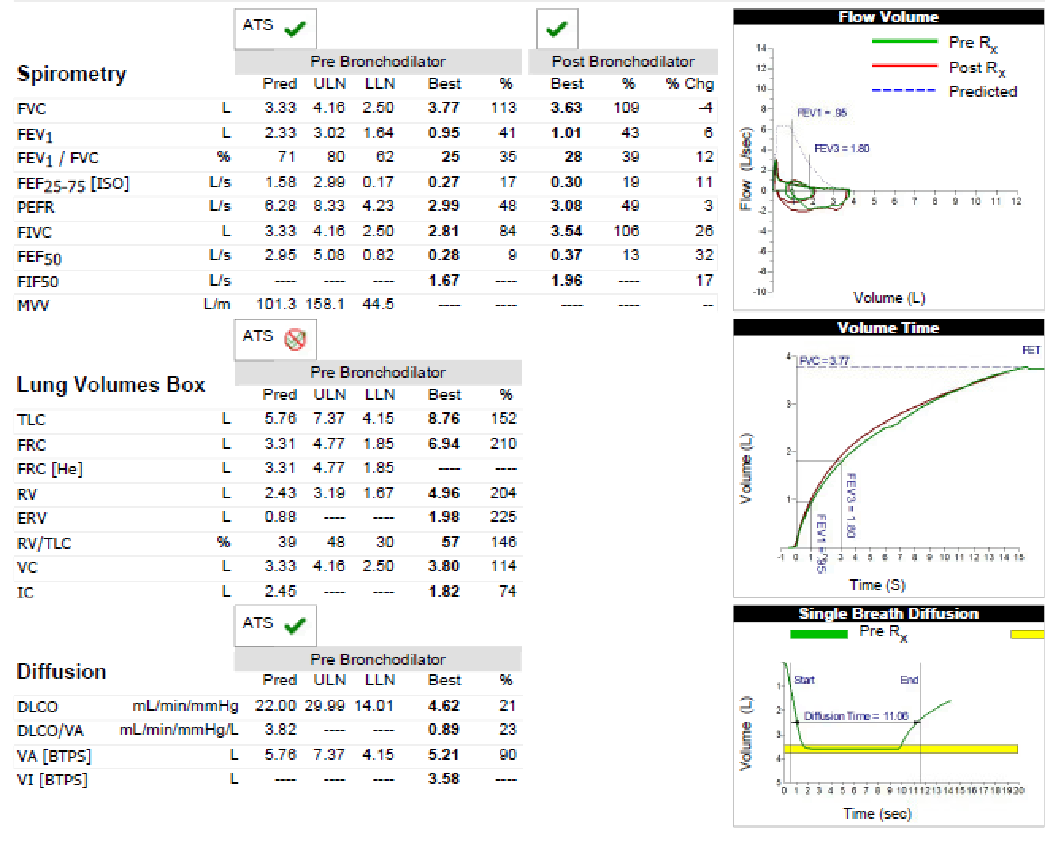

Slide 31
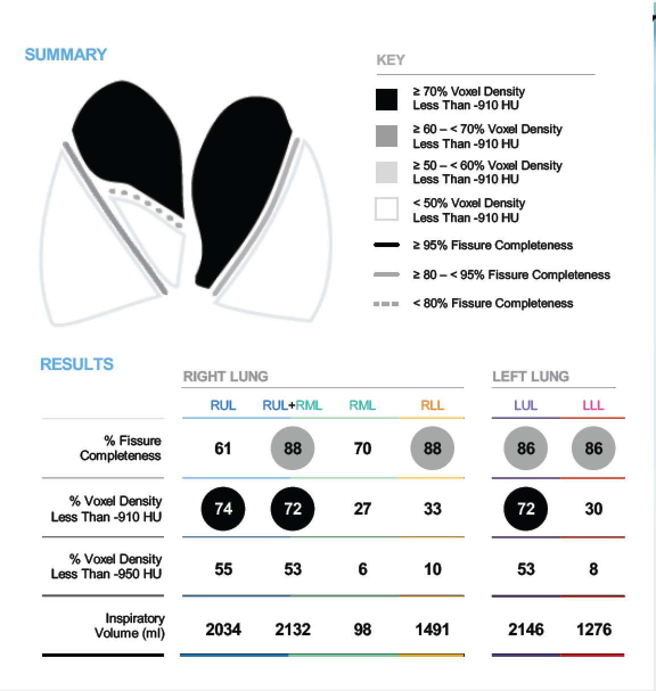

Slide 32
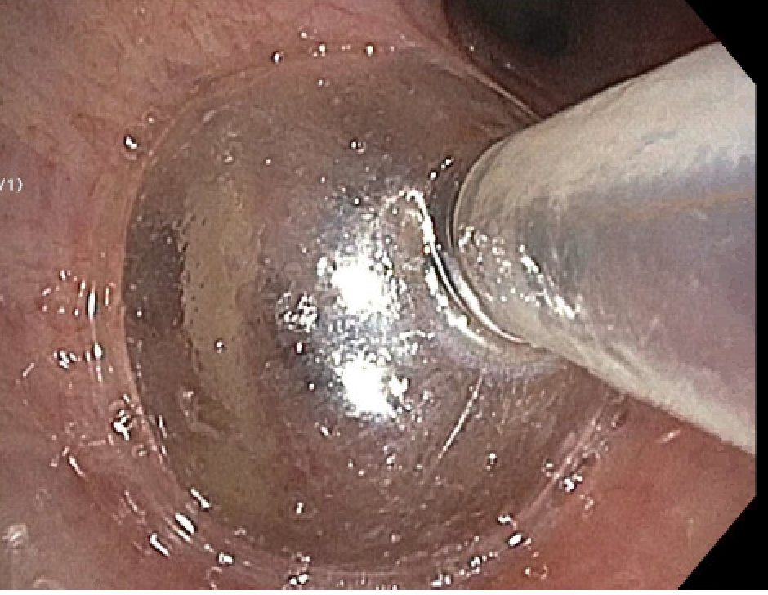

Slide 33
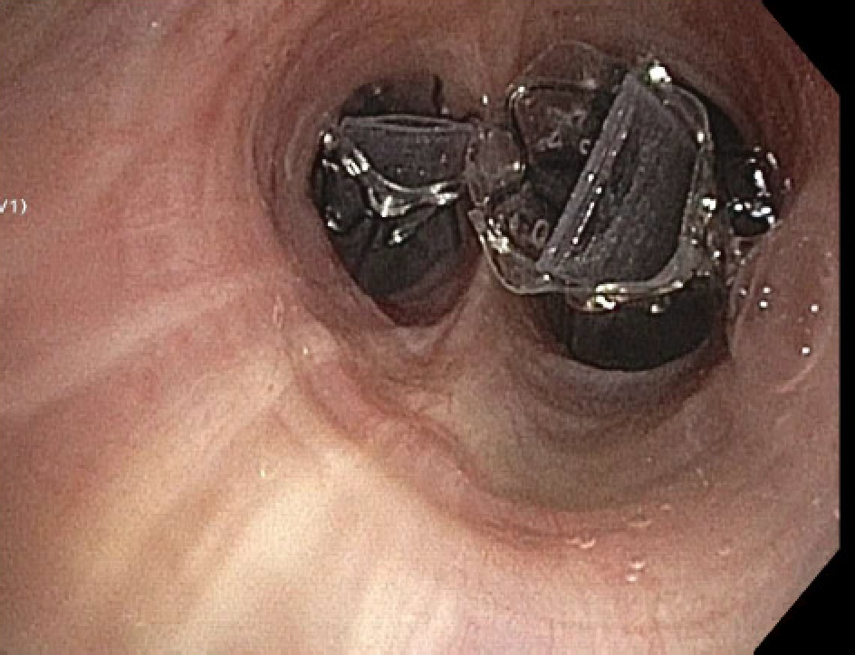
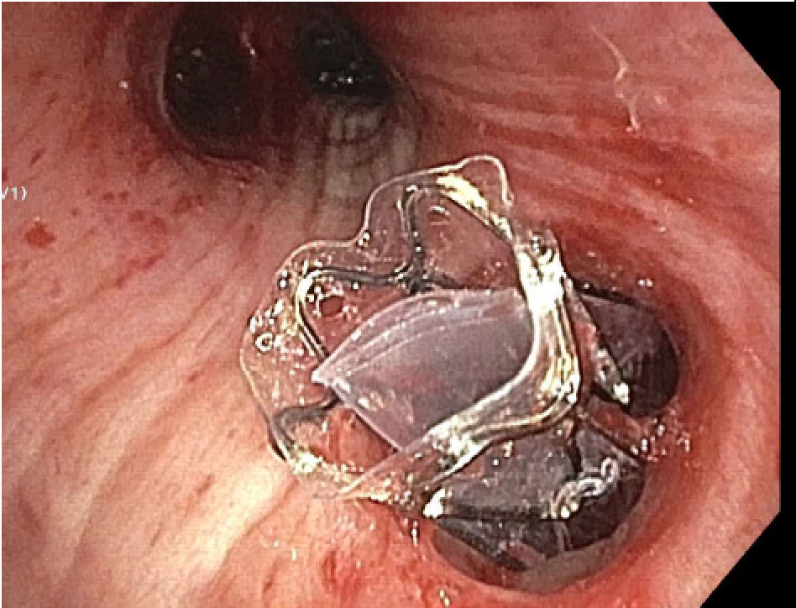

Slide 34
Case Follow-up
Deb is now 2.5 years out from treatment
FEV₁ improved 20%
Quality of life improved
On treadmill for 45 minutes 3 times per week!

Slide 35
Objectives
Review pathophysiology of hyperinflation in severe emphysema
Discuss endobronchial valves, review mechanism of action and inclusion criteria
Discuss outcomes of bronchoscopic lung volume reduction including most recent literature

Slide 36
Benefits
BLVR has been shown to improve lung function (FEV₁) at 3 months
Associated with lower dyspnea scores and improved quality of life
Not proven to reduce mortality in COPD
Some, but not all patients may note improvement in oxygen requirements

Slide 37
Clinical Trials
STELVIO trial:
  FEV₁ improved 21%, FVC improved 18.3%, 6MWD improved 60 m
IMPACT trial:
  FEV₁ improved 100 ml, RV decreased 420 ml, 6MWD improved 22.6 m
TRANSFORM trial:
  FEV₁ improved 20.7%, RV decreased 660 ml, 6MWD improved 36.2 m

Slide 38
Clinical Trials (cont’d)
EMPROVE trial:
  FEV₁ improved 99 ml, TLC decreased 974 ml
LIBERATE trial:
  FEV₁ improved 17.2%, 6MWD improved 12.98 m, average volume reduction 1.142 L

Slide 39
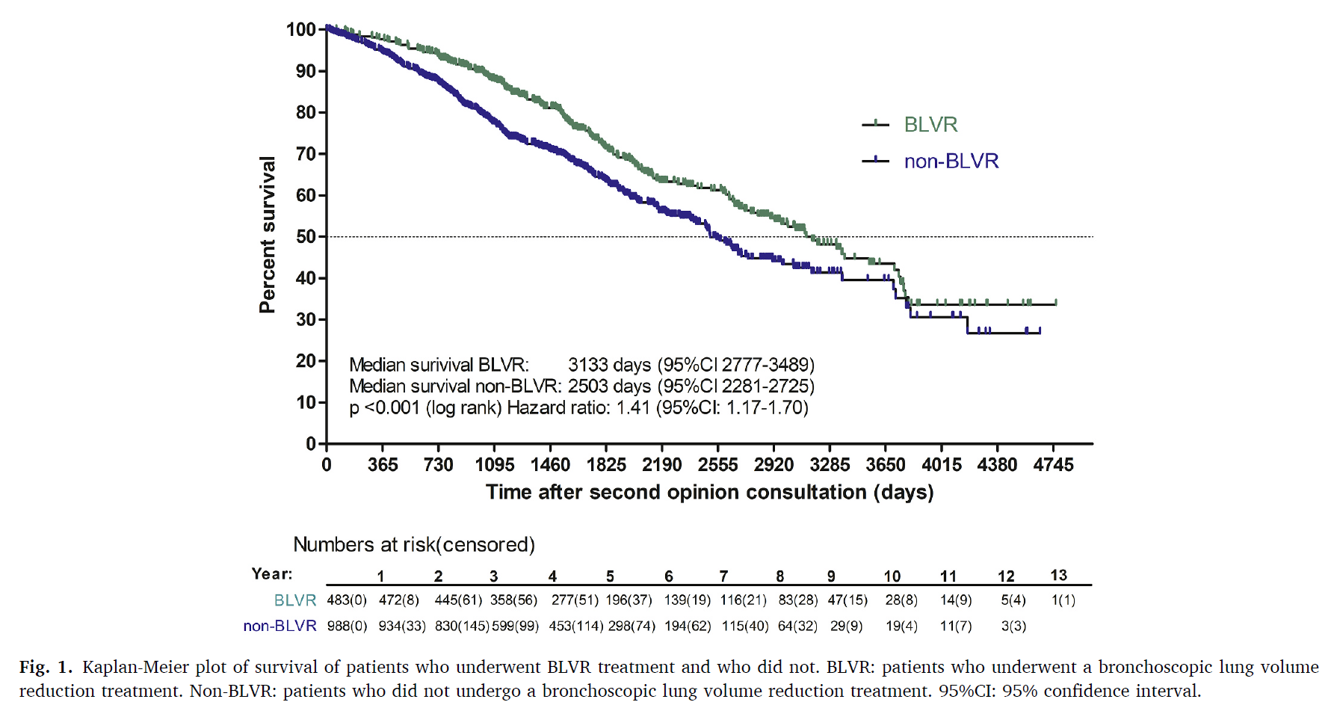
Effect on Survival?
More long-term follow-up data needed to better assess affect of BLVR treatment on longevity in patients with severe COPD
Hartman, et al. Resp Med. 2022

Slide 40
Most Common Complications
20-30% risk of pneumothorax after procedure
  Reason for inpatient hospitalization
  80% of pneumothorax will occur in first 72 hours after procedure
~8-10% risk of COPD exacerbation

Slide 41
LIBERATE Trial Adverse Events
SAEs Occurring in at Least 3% of Subjects, as Defined by Investigators
 | Treatment Period Day of Procedure/ Randomization to 45 Days |  | Longer-Term Period 45 Days from the Study Procedure/ Randomization until 12-month Visit Date
 | Zephyr Valve (N=128) | SoC (N=62) | Zephyr Valve (N=122) | SoC (N=62)
Death | 4 (3.1%) | 0 (0.0%) | 1 (0.8%) | 1 (1.6%)
Pneumothorax | 34 (26.6%)* | 0 | 8 (6.6%) | 0
Severe COPD exacerbation | 10 (7.8%) | 3 (4.8%) | 28 (23.0%) | 19 (30.6%)
Pneumonia | 1 (0.8%) | 0 | 7 (5.7%) | 5 (8.1%)
Respiratory failure | 2 (1.6%) | 0 | 1 (0.8%) | 2 (3.2%)
Arrhythmia | 0 | 0 | 1 (0.8%) | 2 (3.2%)
Diverticulitis | 0 | 0 | 1 (0.8%) | 2 (3.2%)
* p<0.05
Criner G et al, AJRCCM, 2018, Published on 22-May-2018 as 10.1164/rccm.201803-0590OC

Slide 42
Complications (cont’d)
Some patients will require revisions due to either valve migration/malfunction
Minority of patients will require removal due to persistent pneumothorax or infection

Slide 43
GOLD 2023
BLVR included in GOLD 2023 treatment guidelines (Evidence level A) as non-pharmacologic therapy for select patients with advanced COPD
GOLD. 2023 Edition

Slide 44
IU Experience
Treated just over 50 patients thus far
Procedures performed at IUH University Hospital and IUH Methodist Hospital
BLVR working group meets every other week Monday afternoons

Slide 45

“You get weller with Weller”
- Patient

Slide 46
Summary
BLVR can offer meaningful benefits for appropriately selected patients with severe emphysema and lung hyperinflation
Patients required detailed evaluation to determine candidacy
Patients can achieve modest improvements in lung function, but more importantly significant improvements in dyspnea scores and quality of life

Slide 47
Questions?
cmkniese@iu.edu

