Slide 1
IU Health Ball Cardiopulmonary Rehab and Mobile Integrated Healthcare-Community Paramedicine
ISCVPR Annual Meeting
April 24, 2024

Slide 2
Objectives for the Podium to Panel:
Understand
Understand the concept of Mobile Integrated Healthcare-Community Paramedicine (MIH-CP)
Explore
Explore the Care Partnership of MIH-CP with Cardiopulmonary Rehabilitation, Heart/Lung Center, and Outpatient Providers.
Discuss
Discuss key performance indicators and recognize the value of MIH-CP Services.
2

Slide 3
2024 IU Health Ball Model of Care
2

Slide 4
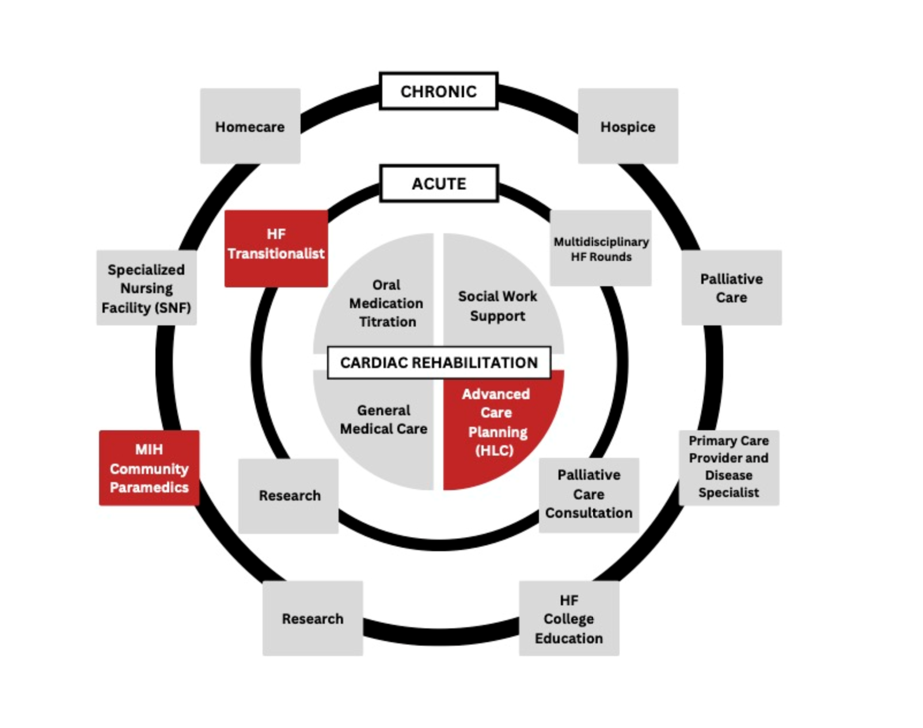
IU Ball Hospital Heart Failure Model of Care
4

Slide 5
2024 IU Health Ball Model of Care
Cardiopulmonary Rehabilitation
4

Slide 6
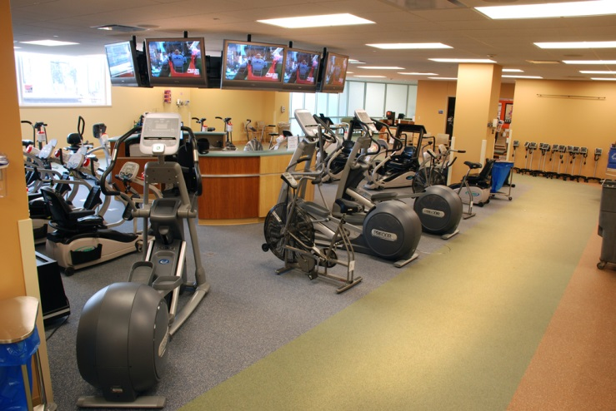
Cardiopulmonary Rehabilitation
1976-Cardiac Rehab started by Dr. Wayne Gray
One of the first programs in Indiana
Collaboration with Ball State University Human Performance Lab/Clinical Exercise Physiology Program for Best Practice Research & Academic On-Site Student Training
1999- Pulmonary Rehab started by Dr. Lynn Witty
AACVPR (American Association of Cardiovascular and Pulmonary Rehabilitation) Certified for since inception (24 years)
Leader in the system in capture of Cardiopulmonary Rehab Referrals
Provides full-service in-patient, early outpatient, and maintenance phases
Helped develop and currently share data to AACVPR National Data Registry
2022 started Virtual/Remote Cardiopulmonary Rehab
2023 started Virtual Remote Cancer and Bariatric Rehab Services
4
Notes:
Get picture of 20 year club-get “personal” Dick Clevenger..Kyle…story to highlight;pics from annual events
<number>

Slide 7
2023 Cardiopulmonary Rehab Program Overview
Cardiac Rehab welcomed 332 patients out of 433 active Ball referrals captured for a 77% enrolled. Our adherence was 81% per AACVPR guideline.
Pulmonary Rehab enrolled 136 patients out of 235 active Ball referrals captured for a 58% enrolled. Our overall adherence was 69% per AACVPR guideline.
Our team is 13 Exercise Physiologists, 2 Respiratory Therapists, 1 Registered Nurse, and 6 Graduate Assistants to cover Inpatient and Outpatient Cardiopulmonary/Cancer/Bariatric Rehabilitation and Graded Exercise Testing. We provide services 6 days/week.
7

Slide 8
2024 IU Health Ball Model of Care
Heart Failure/COPD Transitionalist
7

Slide 9
IU Health Ball HF/COPD Care Continuum
Inpatient
Interprofessional Team
Inpatient
Research
HF/COPD Transitionalist
Community
Heart and Lung Center
Community Paramedicine
Outpatient
Cardiopulmonary
Rehab
IU Health Cardiology/Pulmonology Physicians
Outpatient Palliative Care
Home Health/Telemedicine Skilled Nursing Facilities Hospice
Notes:
We have a 80-hour education and competency for onboarding new team of experienced paramedics.
<number>

Slide 10
Heart & Lung Center Auto Referral Criteria for Heart Failure Patients
One inpatient readmission in 30 days with initial visit diagnosis of Heart Failure
New Diagnosis
of Heart Failure
7

Slide 11
Heart & Lung Center Auto Referral Criteria for COPD
One inpatient readmission in 30 days with initial visit of COPD
Known COPD with Spirometry GOLD Stage III or IV
First Time COPD/Emphysema Diagnosis while inpatient
Current smoker/history of smoking with emphysema on CT or CXR
Current smoker/history of smoking with O2 requirement 4L or greater at discharge
Any stage COPD post-COVID
EXCLUSION CRITERIA:
Pulmonary fibrosis, current oncology care for lung cancer, GOLD Stage IV COPD failing treatment and requiring lung transplant
11

Slide 12
2024 IU Health Ball Model of Care
Heart and Lung Center
11

Slide 13
Call to Action
Provide information regarding HF and COPD admissions.
Provide information regarding 30-day readmissions for HF and COPD.
Potential cost of these admissions
Learn demographics about HF and COPD and our local population.
Reduce unnecessary readmissions for HF and COPD for IU Health East Central Region
11

Slide 14
Heart Lung Center Timeline
September 2016, we opened our Heart and Lung Center within the Internal Medicine Residency Suite to see Systolic HF patients
December 2016, we completed our first home visits with HF patients with our Community Paramedic.
In 2018, we became a Magnet Certified Hospital, and our Heart and Lung Center was named a Magnet Exemplar.
In 2020, we began seeing COPD patients in the Heart and Lung Center
The Heart Failure/COPD Clinical Effectiveness Team (CET) was formed in 2020. Dr. Kolli became the medical director and COPD metrics were created to evaluate the efficacy of inpatient and outpatient services.
11

Slide 15
COPD Volumes
Since adding COPD to the HLC 588 patients have been referred (2020 – 2023).
Most referrals come from the “auto trigger” process.
HLC providers have done outreach to primary care and internal medicine practices to increase referrals.
In 2023, the HLC offered same day visits for urgent needs 98% of the time
Provide services offered including same day visits for IV solumedrol, diuretics, on site nebulizers, labs, and imaging.
11
Notes:
<number>

Slide 16
IV Solumedrol
IV Solumedrol
Nebulized Medications
Nebulized Medications
Lab Collection
On Site Services
In Home Services
Antibiotic/steroid prescriptions
Medication Reconciliation
Referral to specialty care
Inhaler technique
Radiology Imaging
11
Notes:
<number>

Slide 17
“Blue Dollar” Savings
From its inception in 2016, the HLC has not been considered a revenue generating entity.
Rather, it’s success is defined by cost prevention.
It is difficult to estimate the savings of patients who remain stable and do not require acute hospitalization for exacerbation of illness.
However, to illustrate the potential savings generated by enrolling a patient in HLC, a “Blue Dollar Savings” formula was created using the following formula.
The average cost of observation/acute care bed is estimated at $3200 per day
The average length of stay for COPD exacerbation is 4-5 days
Thus, each prevented admission may result in an estimated $16,000 savings
There is no perfect metric to measure a patient who was NOT admitted. To approximate this figure, each urgent visit to HLC which resulted in IV therapy (Lasix/Solumedrol) will be counted as a prevented admission, or a Blue Dollar Save.
There were 9 such urgent visits in January 2024, resulting in an estimated $115,200 savings
11

Slide 18
Heart & Lung Center Services Summary
We have seen 317 new HF/COPD patients enrolled since last year.
Maintained an overall less than 16.92% readmission rate for HF in the 668 patients served over 12 months. Also, a 37% COPD readmission avg. for 2023, but with a very high 6-month mortality.
HLC accounted for 1,689,600 in blue dollar savings to our institution for the past 9 months of 2023.
New partnership with the TAVR program to optimize patient’s HF care pre/post the valve procedure.
18

Slide 19
2024 IU Health Ball Model of Care
Mobile Integrated Healthcare-Community Paramedicine
18

Slide 20
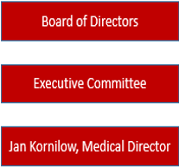
IU Health ECR MIH-Community Paramedicine Organizational Chart
18

Slide 21
ECR Mobile Integrated Healthcare
Community Paramedicine Services
Heart & Lung Center
Cardiology
CV Surgery
Internal Med. Residency Clinic
Case Management
Home Health/Telemedicine Skilled Nursing Facilities Hospice
18

Slide 22
ECR Community Paramedic
Core Elements of Standard Work
Regular in-home visits 24-48 hours post-discharge or outpatient provider order
Participation in interprofessional rounding with HF/COPD Transitionalists
Reinforcement of discharge instruction, self-management education, medication reconciliation and device management (CardioMems, LifeVest, LVAD)
Assistance in coordinating appointments with PCP, Clinic Providers, Cardiopulmonary Rehabilitation, and Community Resources.
18

Slide 23
IU Health Community Paramedic Heart Failure Standard Protocols
Discuss Common Language HF Education
Review Fluid Restrictions
Review Daily Weight Chart
Discuss Dietary Restrictions
Medication Reconciliation
Administer IV Lasix
Draw Labs
Obtain 12 Lead EKG
CardioMems Management
18

Slide 24
IU Health Community Paramedic COPD Standard Protocols
Provide Common Language COPD Education
Breathing Techniques
Medications compliance (ex Nebs, MDI's)
Administer emergency duo nebulizer treatments
Discuss smoking cessation
Home oxygen evaluations
Draw Labs
18

Slide 25
IU Health Community Paramedic Post Acute MI Standard Protocols
Assessment & Education following d/c
Obtain 12 lead EKG
Medication compliance
Draw Labs
Life Vest
18

Slide 26
IU Health Community Paramedic Post Cardiovascular Surgery Standard Protocols
Review Restrictions following surgery
Wound/incision assessment
Obtain 12-lead
Draw Labs
18

Slide 27
Community Paramedicine
Referral Process
IU Health Inpatient/Observation Status Provider or Auto Trigger Referral
Outpatient Provider Referral
Heart & Lung Center (includes Community Paramedic)
Community Paramedic Referral with
Provider Oversight
(Non-Hospitalist)
Community Paramedic Referral with
Outpatient Provider Oversight
Notes:
<number>

Slide 28
Proven Outcomes
ECR Community Paramedicine
Reduced readmissions in patients with that d/c to home (HF and COPD)
Increased medication accountability, education, and compliance
Individualized self-care education in inpatient, office, and in the home
Easy access to patient and/or provider questions with quick response deterring unnecessary ED visits
Ability to have assessments, labs, nebulizers, and ECGs done in the home
Education to increase use of home devices through education and paramedic protocols
18

Slide 29
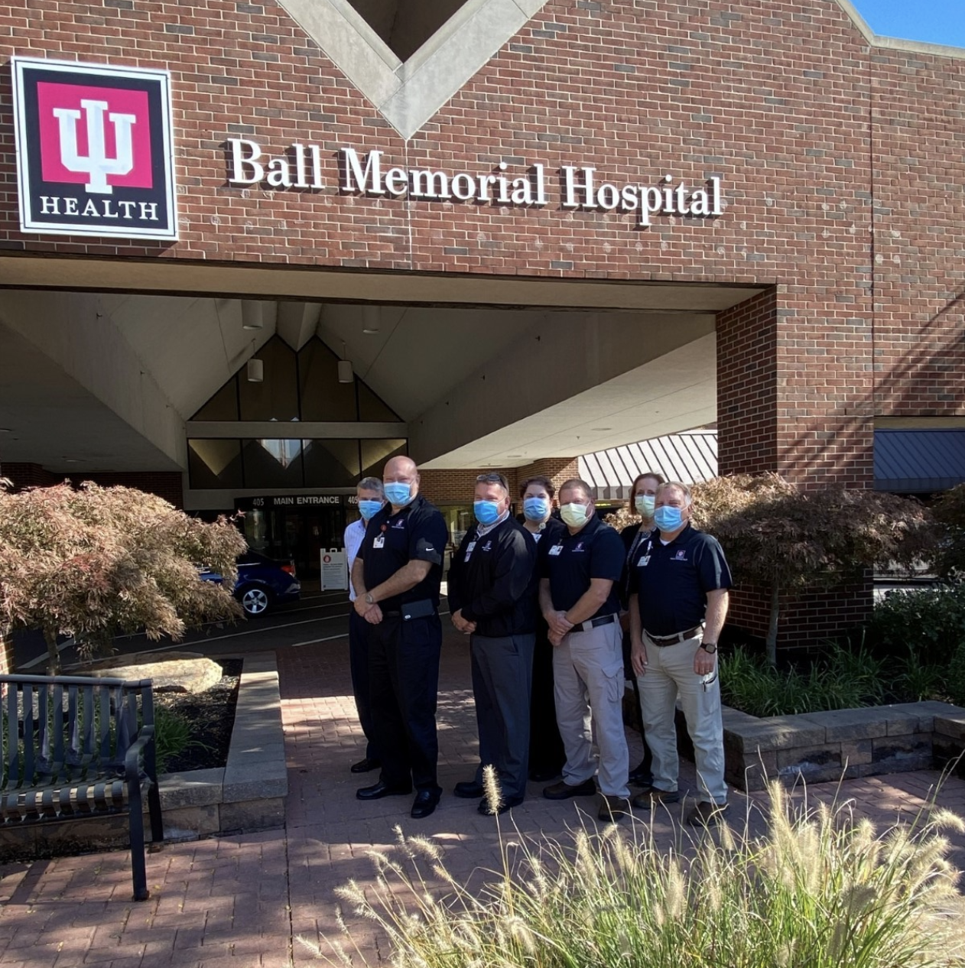
2021 ECR Community Paramedicine Program Certification
The IU Health East Central Region Community Paramedicine/Integrated Mobile Healthcare Services team has been awarded a newly created Indiana state certification. The certification indicates the best practice and highest quality care from services operating as mobile integrated healthcare and is awarded by the Indiana Department of Homeland Security, EMS Division and the EMS Commission.

Slide 30
Highlights and Upcoming Work from the Community Paramedicine Program
We have seen 200 more patients in 2023.
Increased activations from more PCP offices across the region over the previous year.
Increased utilization of lab draws, Lasix, and Solumedrol in the home.
Research completed with Internal Medicine Residency on hypertension management in our underserved populations.
Recognized as a Center for Disease Control (CDC) Million Hearts Best Practice for collaboration of Cardiac Rehab Services in high-risk HF patients.
An additional one million dollars saved to IU Ball in cost avoidance due to reduced readmissions over the contribution of the Heart and Lung Center.
Upcoming implementation of remote monitoring program with an independent dashboard through our Mobile Integrated Healthcare-Community Paramedicine Program
30

Slide 31
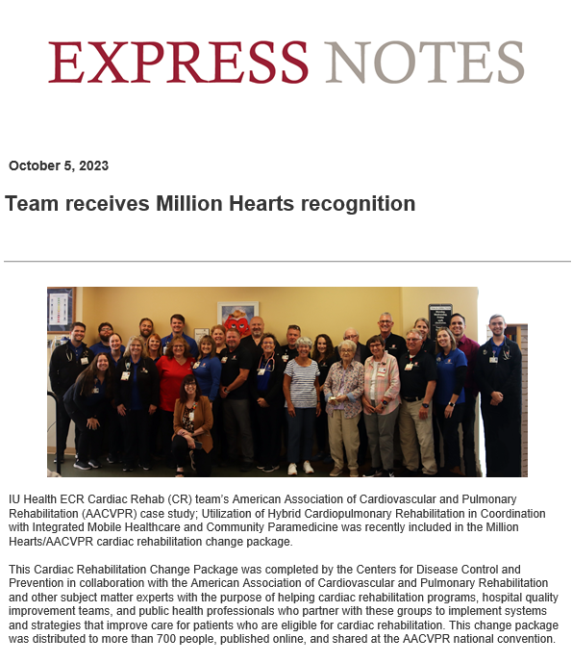
30

Slide 32
Thank You- Questions?
<number>

