Slide 1
CardioOncology: The Promise and Pitfalls of Personalized Medicine
Vijay U. Rao, MD, PhD, FACC, FASE, FHFSA
Franciscan Physician Network Indiana Heart Physicians
Director, Franciscan Health Inpatient Heart Failure and CardioOncology Clinic, Co-Director Anti-coagulation Clinic

Slide 2
Presenter Disclosure Information CardioOncology:The Promise and Pitfalls of Personalized Medicine Vijay Rao, MD, PhD, FACC, FASE, FHFSA
No relevant disclosures related to this talk
I will not discuss off label or investigational use in my presentation.

Slide 3
Why a new subspecialty of Cardiovascular Medicine?
“This exciting new field spans broad areas of cardiovascular medicine, from basic mechanisms of cardiovascular toxicities, translation and risk stratification using cardiovascular imaging and biomarkers, to clinical strategies aimed at prevention and treatment of cardiovascular disease in patients undergoing cancer treatments and cancer survivors. Rapidly growing market of novel and emerging cancer therapies and rising number of patients living with and surviving cancer, often in the setting of new or pre-existing cardiovascular disease and risk factors, have created a need for specialty cardiovascular care. ”
Anna Barac, MD, PhD, Section Lead ACC CardioOncology

Slide 4
2015 CDC US Mortality Data

Slide 5
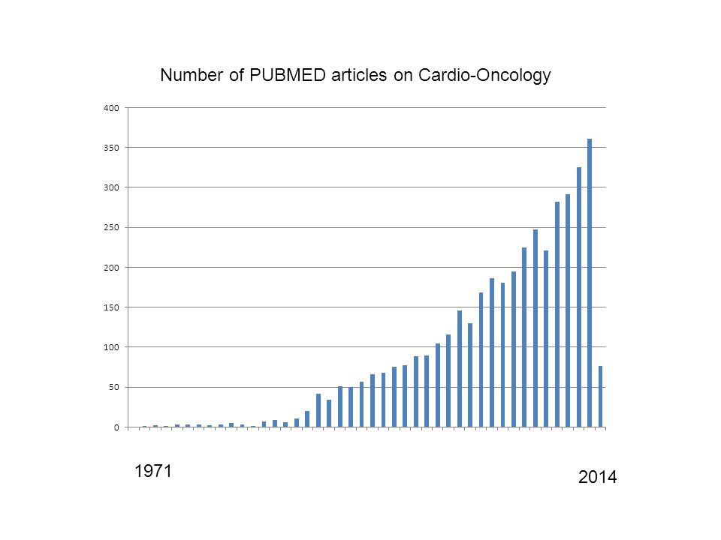

Slide 6
Outline
CardioOncology: Historical perspective
Anthracyclines
Radiation therapy
Molecular Targeted Therapies (Precision Medicine)
Trastuzumab (Herceptin®)
Tyrosine Kinase Inhibitors (TKIs)
Immune Checkpoint Inhibitors (ICIs)
Franciscan CardioOncology Clinic
New Frontier: exercise/rehab for cancer patients

Slide 7
Anthracyclines
In the 1950s, daunorubicin, a compound isolated from the soil bacterium Streptomyces peucetius, was found effective against tumors in mice, and eventually, acute leukemia and lymphoma.
Among the most effective anticancer treatments ever developed and are effective against more types of cancer than any other class of chemotherapeutic agents
MOA: intercalates between DNA/RNA, affects topoisomerase II, free radial generation
- Associated with troubling side-effect: cardiotoxicity (in some cases: irreversible), many of whom went to require heart transplant

Slide 8
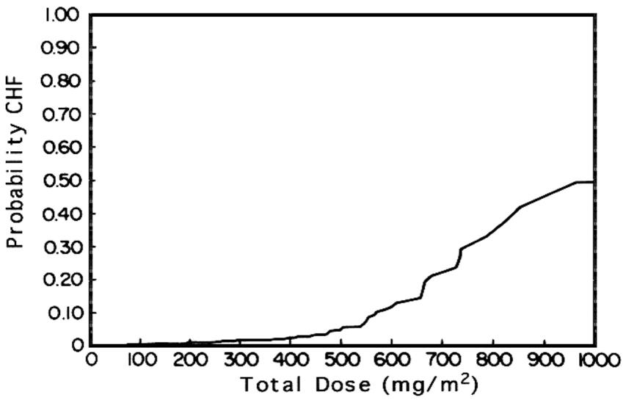
Anthracycline Dose Cardiac Toxicity
Shan et al. Ann Intern Med. 1996;125(1):47-58.

Slide 9
Berry GJ, Jorden M. Pediatr Blood & Vancer 2005:44:630-7

Slide 10
Ewer MS and Ewer SM. Nat. Rev. Cardiol. 2010; 7,564–75

Slide 11
Jensen BV et al. Ann Oncol 2002 13:699-709

Slide 12
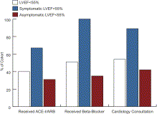
Cardinale D et al. JACC 2010,55:213-20

Slide 13
Cardinale D et al. JACC 2010,55:213-20

Slide 14
CardioOncology Mission
“One of the goals of cardio-oncology is to prevent the cancer survivor of today from becoming the heart failure patient of tomorrow.”

Slide 15
Radiation Therapy and CV disease
XRT: curative vs palliative intent
Mantle Cell Lymphoma, Adjuvant therapy in breast cancer, Hodgkin’s lymphoma, lung cancer
Cardiac complications when dose is greater than 30 Gy
Shrinking problem: breath holding technique, shielding, smaller fractions, PET scans

Slide 16
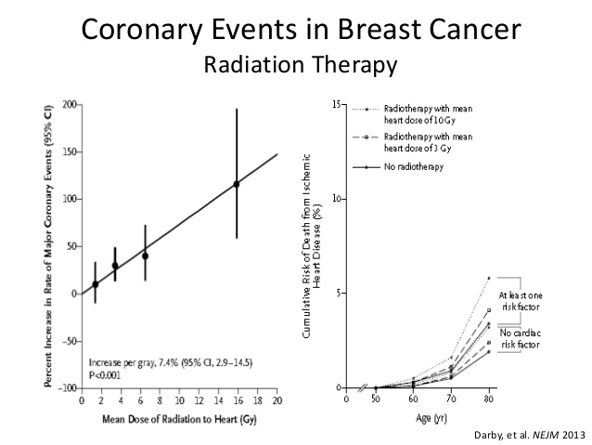
Incidental exposure of the heart to radiotherapy for breast cancer
increased the rate of major coronary events by 7.4% per gray,
with no apparent threshold. The percentage increase per unit
increase in the mean dose of radiation to the heart was similar
for women with and women without preexisting cardiac risk
factors

Slide 17
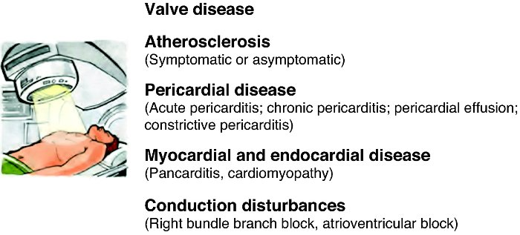
Radiation Induced Cardiotoxicity

Slide 18
ASE – ESC Expert Consensus 2014

Slide 19
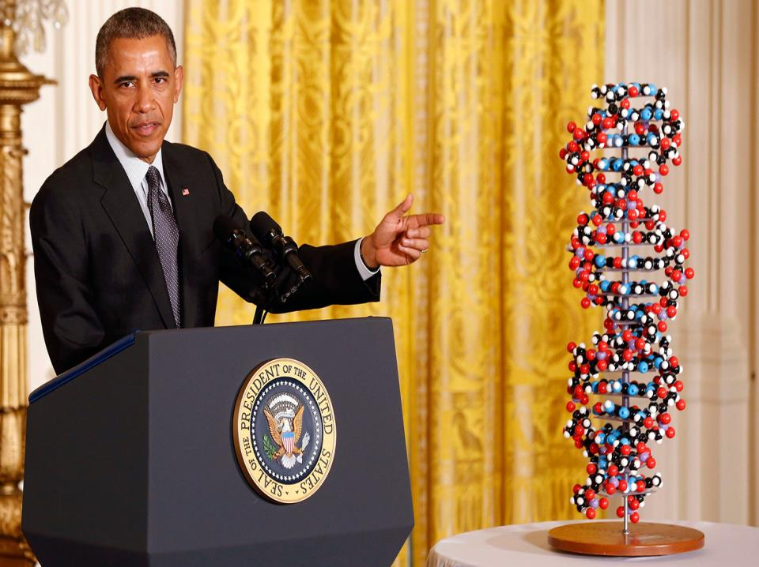

Slide 22
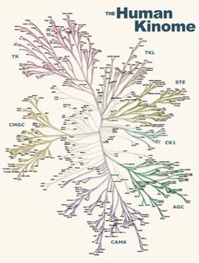

Slide 23
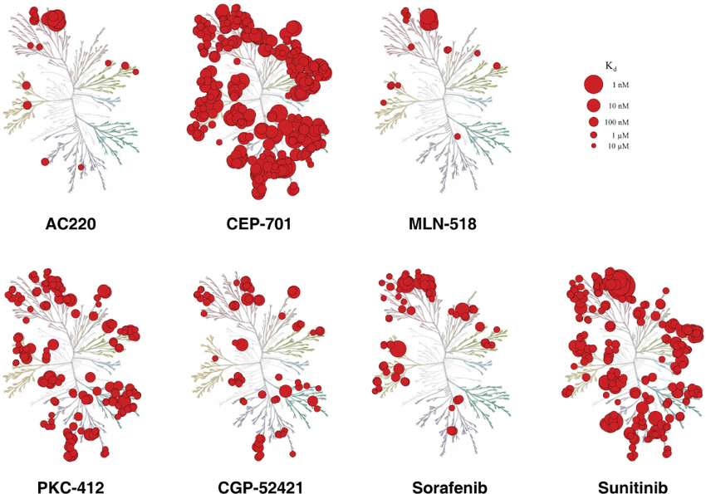

Slide 24
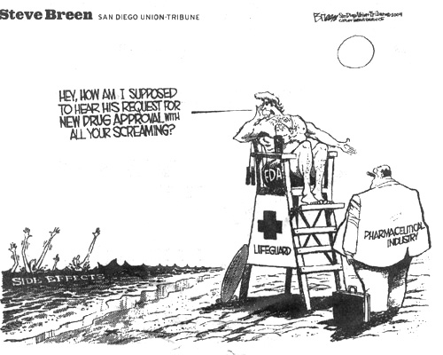

Slide 25
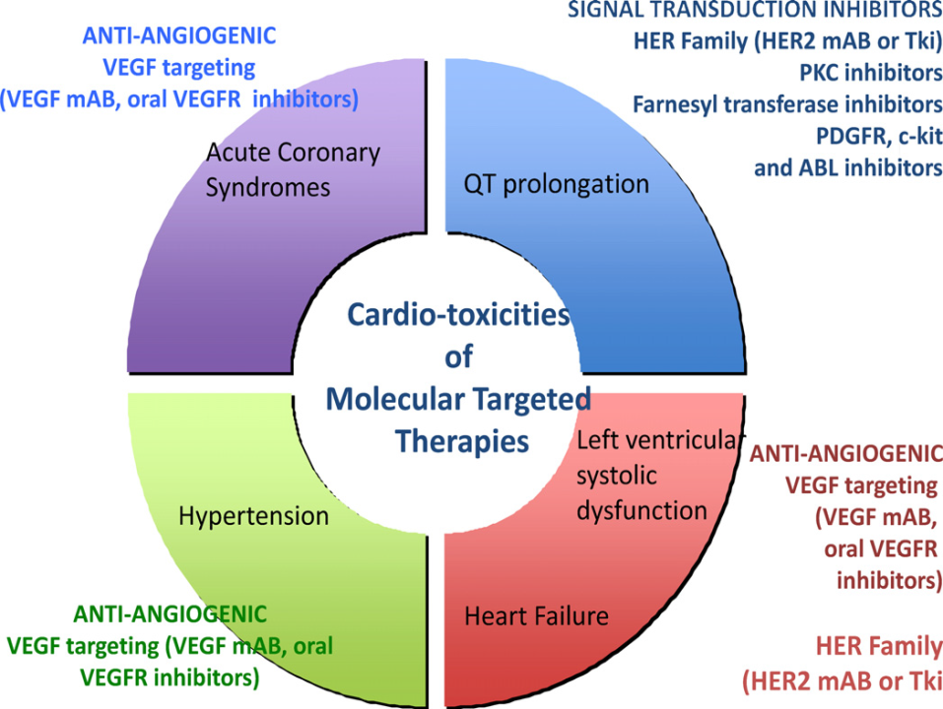

Slide 27
Murphy CG and Morris PG. Anti-Cancer Drugs 2012, 23:765–76

Slide 28
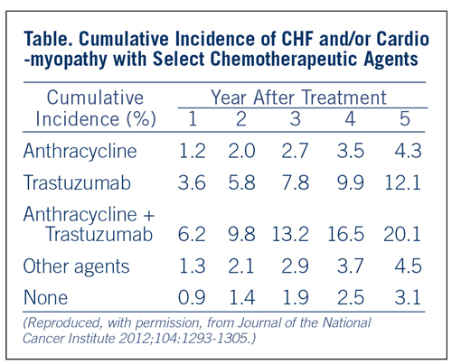

Slide 29
Ewer MS et al. J Clin Oncol 2005;23:7820-6

Slide 30
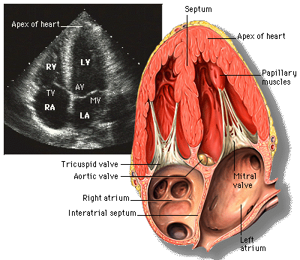
Echocardiography

Slide 31
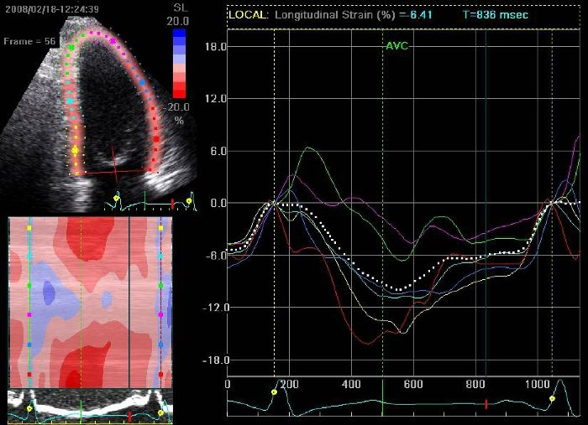
Myocardial strain analysis
10-15% drop in GLS by STE predicts future drop in EF for both anthracycline and trastuzumab chemotherapy [Thavendiranathan et al JACC 2014 volume (63):2751]

Slide 32
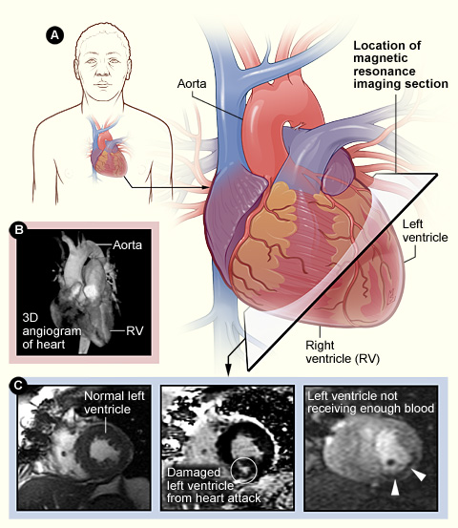
Cardiac MRI

Slide 33
Angiogenesis Inhibitors: HTN
Drugs: Sorafenib (VEGFR, PDGFR and Raf family kinases), Bevacizumab (VEGFR), Sunitinib (VEGFR, PDGFR)
Metastatic renal cell cancer, ovarian cancer, metastatic colorectal cancer
Prevalence: 15-60% develop HTN (link between HTN and improved progression free survival)
Risk Factors: Hx of HTN, >1 combo therapy, >65 yo, smoking, HL
Treatment: Ace-Inhibitors and/or dihydropyridine calcium channel blockers; avoid inhibitors of CYP3A4 (diltiazem, verapamil) as TKIs are substrates, could consider nevibolol (Bystolic) (beta-blocker which increases NO bioavailability); Franciscan grant written to test this
May need to decrease dose or halt therapy until HTN controlled; HTN resolves once agent stopped

Slide 34
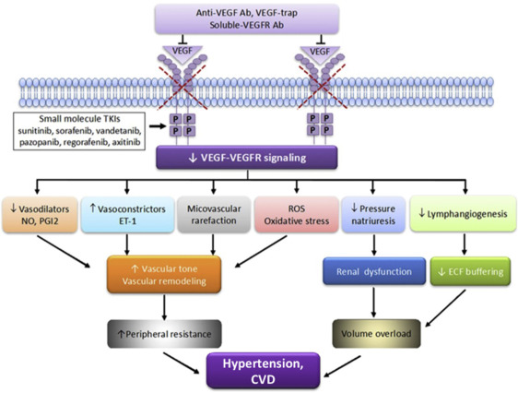
VEGF Inhibition links to CV disease
Toyez et al. JASH, June 2018: Volume 12, Issue 6, Pages 409–425

Slide 35
Franciscan Health: CardioOncology Clinic
8 Oncologists, 4 Cardiologists, 2 nurse navigators (oral agents/iv agents), one dedicated MA, dedicated clinic ½ day every two weeks
Prevention/screening for cardiotoxicity and CV complications of cancer therapy
Increase awareness about topic and clinical considerations among PCPs, cardiologists, and the health care team (ex physiologists)
Increase access to subspecialty expertise (telemedicine initiative with Franciscan outreach)
Contribute to research in the field
Incorporating CRS (cardiotoxicity risk score) in cardio-onc setting (chemotherapy risk + patient CV risk factors), embedded in EMR for cancer patient intake; guide for referrals to clinic
TKI-HTN grant; nebivolol (Dr. Chugh)
SURVIVE registry (Dan Lenihan at Wash U; 10 sites globally)
Banking serum samples and 6 min walk test
Patients with cardiotoxicity or “at-risk” for cardiotoxicity

Slide 37
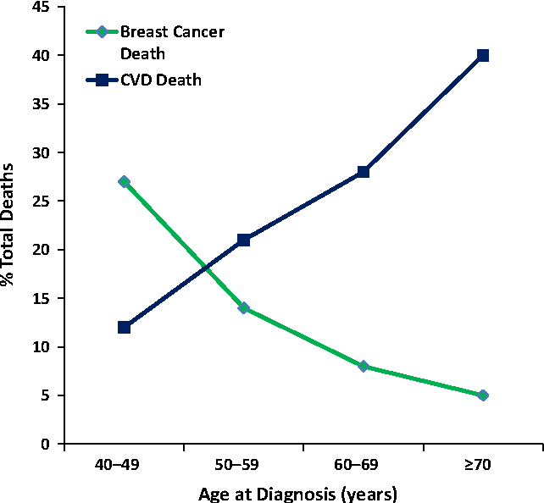
Fig. 1 Percentage of total cardiovascular deaths versus breast cancer deaths by age of ductal carcinoma in situ (DCIS) diagnosis
Berkman et al. Breast Cancer Research and Treatment 2014
DOI:10.1007/s10549-014-3168-3

Slide 38
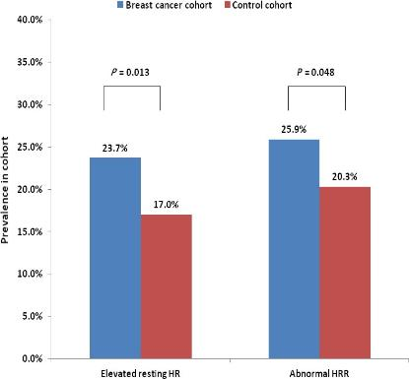
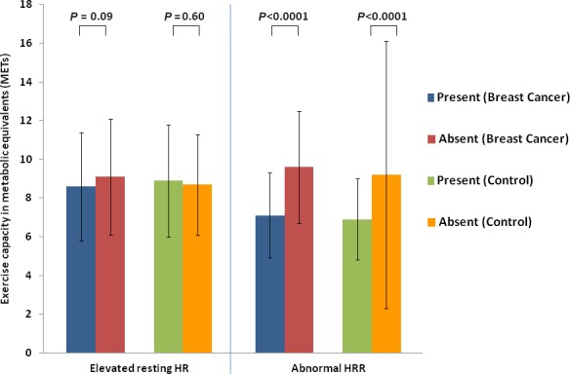
Case-control study of heart rate abnormalities across the breast cancer survivorship continuum
Groarke JD, et al. Cancer Med. 2019 Jan;8(1):447-454. doi: 10.1002/cam4.1916. Epub 2018 Dec 21

Slide 39
Personalized Exercise Therapy in Cancer
What we know: Exercise therapy improves a patient’s CVD risk profile
favorable alterations in insulin sensitivity, lipid profile, and blood pressure with concomitant improvements in the reserve capacity of the skeletal muscle/vasculature/cardiovascular axis
Across 26 studies of breast, colorectal, and prostate cancer patients, a 37% reduction was seen in risk of cancer-specific mortality, comparing the most versus the least active patients (pooled relative risk = 0.63; 95% confidence interval: 0.54-0.73) (Friedenriech CM et al. Clin Cancer Res. 2016 Oct 1;22(19):4766-4775. Epub 2016 Jul 12)

Slide 40
Individualization
Exercise exposure (≥ 9 metabolic equivalents of task hours of physical activity per week) was associated with a substantial 50% reduction in breast cancer death in estrogen receptor (ER)–positive tumors compared with a nonsignificant 9% reduction in ER-negative tumors. JAMA. 2005;293:2479-2486.
The exercise prescription must be specific and targeted to the primary endpoint or system(s) or pathway(s) known or postulated to underpin the effects of exercise on the primary therapeutic target.
In the context of breast cancer that are ER positive, exercise prescriptions should be designed to optimally inhibit ER activity, its ligands, or coactivating pathways.
Increasing exercise is associated with linear reductions in the risk of recurrence and cancer mortality but only up to a specific threshold; exercise exposure beyond this threshold is associated with an attenuated effect on cancer outcomes, suggesting that an upper threshold or optimal dose of exercise exists to impact cancer outcomes

Slide 41
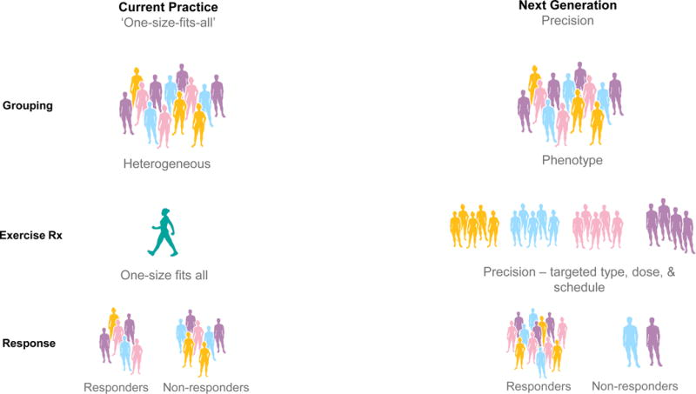
Current and next generation practice in exercise oncology. Current practice (left column) stratifies patients based on tumor type, provides a generic exercise
prescription (typically based on predicted maximum heart rate), resulting in a heterogeneous
response. Next generation practice (right column) stratifies patients based on multiple factors,
provides a targeted exercise prescription based on phenogroup, resulting in optimized efficacy,
safety, and tolerability of exercise therapy. CPET, cardiorespiratory exercise test, CRF,
cardiorespiratory fitness, Rx, prescription.
Therapy and Cardiovascular Toxicity in Cancer
Scott JM et al. Circulation. 2018 Mar 13;137(11):1176-1191.

Slide 42
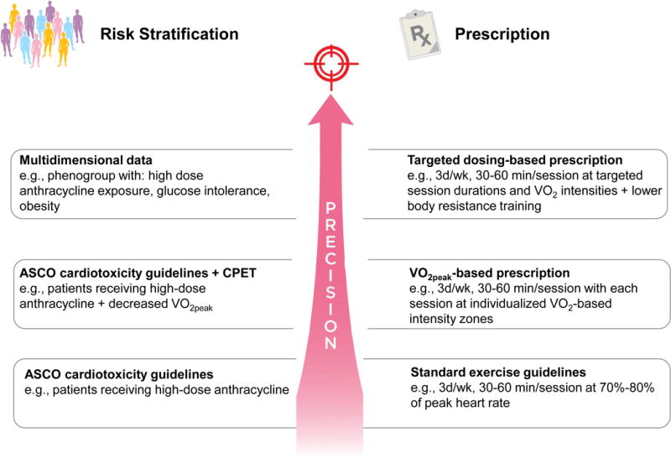
Screening/exercise prescription approaches in oncology. Three example screening/exercise prescription approaches that could be
applied to research investigations designed to assess the efficacy of
exercise on cardiovascular toxicity in the oncology setting:
guideline based approach (bottom row) applies ASCO cardiotoxicity
guidelines and standard exercise guidelines;
(2) ASCO guidelines and VO_{2peak}-based approach (middle row) applies the addition
CPET for risk stratification and exercise prescription design;
(3) multidimensional data approach (top row) applies advanced analytics for both risk
stratification and targeted exercise prescription design. ASCO,
American Society of Clinical Oncology; CPET, cardiorespiratory exercise test.

Slide 43
Bench-to-Bedside Approaches for Personalized Exercise Therapy in Cancer Authors: Lee W. Jones, PhD, Neil D. Eves, PhD, and Jessica M. Scott, PhD ASCO Meeting Library 2017

Slide 44
Cardio-Oncology Rehabilitation to Manage Cardiovascular Outcomes in Cancer Patients and Survivors: A Scientific Statement From the American Heart Association.
Gilchrist SC et al.
Circulation. 2019 Apr 8:CIR0000000000000679. doi: 10.1161/CIR.0000000000000679. [Epub ahead of print]
CardioOncology Rehabilitation (CORE)
Referral is not driven by a specific point in the cancer continuum but rather by a patient’s underlying risk of cardiac dysfunction; referral can be during therapy or in the survivorship period
CORE: patient assessment, nutrition counseling, weight management, bp/lipid/DM2 management, tobacco cessation, psychosocial and physical activity management
Highly individualized (type and duration)
CORE can be center or home based
Need research in field so can pave wave for reimbursement
Track all outcomes including economic (downstream healthcare use, ability to return to work, etc).

Slide 45
Vijay U. Rao
Vijay.rao@franciscanalliance.org
Franciscan Health Cardio-oncology Team

Slide 46
References
Cardiovascular Toxic Effects of Targeted Cancer Therapies
Javid J. Moslehi, M.D.
N Engl J Med 2016; 375:1457-1467 October 13, 2016 DOI: 10.1056/NEJMra1100265
SCAI Expert Consensus Statement: Evaluation, Management, and Special Considerations of Cardio-Oncology Patients in the Cardiac Catheterization Laboratory Iliescu et al.
Catheterization and Cardiovascular Interventions 00:00–00 (2015)
Expert consensus for multimodality imaging evaluation of adult patients during and after cancer therapy: a report from the American Society of Echocardiography and the European Association of Cardiovascular Imaging. Plana, J.C et al.
J Am Soc Echocardiogr. 2014; 27: 911–939

Slide 47
Pharmacologic Treatment for Anthracycline and Trastuzumab Cardiotoxicity
Ace-Inhibitors/Angiotensin Receptor Blockers
Beta-blockers (carvedilol, nebivolol)
Statins
Dexrazoxane

Slide 48
PRADA study
2 x 2 factorial design studying effects of candesartan vs metropolol succinate on change in LV function (cMRI EF) with anthracycline chemotherapy in adjuvant setting for breast cancer with or without trastuzumab and/or radiation
120 patients followed up to 61 weeks
Principal Findings:
The primary outcome, decline in LVEF from baseline to end of the study, was -0.8% in the candesartan group versus -2.6% in the placebo group (p = 0.026 for between-group difference). Findings were the same among all tested subgroups. Metoprolol was not associated with a change in LVEF versus placebo. Findings were the same among all tested subgroups as well.
Gulati G, Heck SL, Ree AH, et al. Eur Heart J 2016;Feb 21:[Epub ahead of print].

