Slide 1
Nutrition Trends: What the Evidence Supports
Connie J Wilson ND, MSN, RN, CCRP, CCEP,
Certificate in Pulmonary Rehabilitation

Slide 3
Nutrition Vs Diet
The process of providing or obtaining food necessary for health and growth
The kinds of food that a person, animal or community habitually eats

Slide 4
Diet and COPD Patients

Slide 5
Change in forced expiratory volume in 1 s (FEV₁) over the 3-yr dietetic intervention study period in patients who followed a diet rich in fruit and vegetables (□) and in those who followed a free diet (▪). Data are presented as mean±sem. The difference in mean annual decline in FEV₁ between the two groups obtained by a general linear model for repeated measures with Bonferroni adjustment gave a p-value of 0.03. % pred: % predicted.

Slide 6
Conclusions
3 year study including 120 patients
Patients with the increased fruits and vegetables had an increase in lung function demonstrated by increase in FEV1
Patients with Standard diet had a decrease in FEV1
Encourage our COPD patients to increase fruits and vegetables could have a positive impact on their outcomes and quality of life

Slide 7
Vitamin A
Georgetown University School of Medicine
Studied rats with emphysema
The rats given the a form of Vitamin A supplement were able to
Regenerate alveoli to normal size and number in essence reversing the emphysema changes

Slide 8
Vitamin D
Study performed in a Belguim pulmonary rehabilitation program
3 months and 50 patients were randomized
Half got Vitamin D supplement half placebo
The group who got the Vitamin D had improvement in respiratory muscle strength and could exercise for longer and more intensity than the placebo group.

Slide 9
Foods high in Vitamin A & D
Vitamin A foods: Carrots, Sweet Potatoes, King Mackerel, Salmon, Goat Cheese, Cheddar Cheese, Eggs, Trout, Paprika, Mangoes, Mustard Greens,
Butternut squash, whole milk, Dried Basil, Kale, Grapefruit
Vitamin D foods: Cod liver oil, Salmon, Tuna, Trout, Fortified Milk, Fortified yogurt, Almond Milk, Orange Juice, Pork Chops, Sardines, Eggs, Chicken, Beef, Cod, Cheddar Cheese, Mushrooms
Food sources of vitamins are safer and better than supplements

Slide 10
Keto Diet
Good Fats should be 75% of daily calories
Sources: Olive oil, ghee, nuts, seeds, avocado
Protein should be 20% of daily calories
5% Carbs or under 50 Grams daily
Should come from complex carbs such as fruits and vegetables that are high in antioxidants

Slide 11
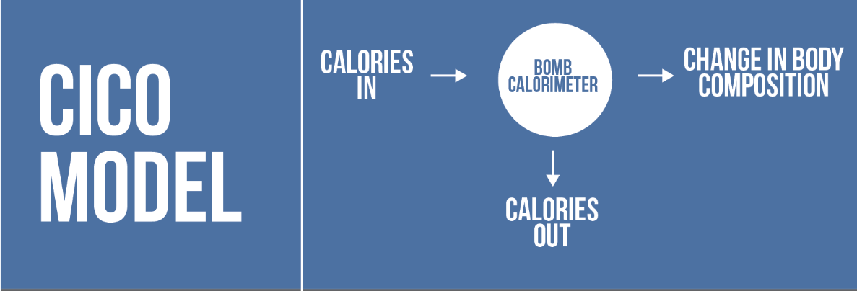
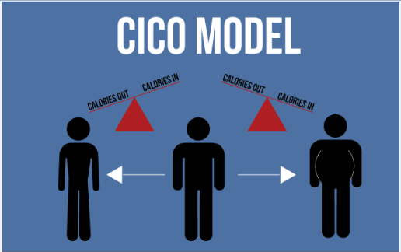
CICO: A calorie is a calorie, it does not matter what type of calorie it is, they are all equivalent.

Slide 12
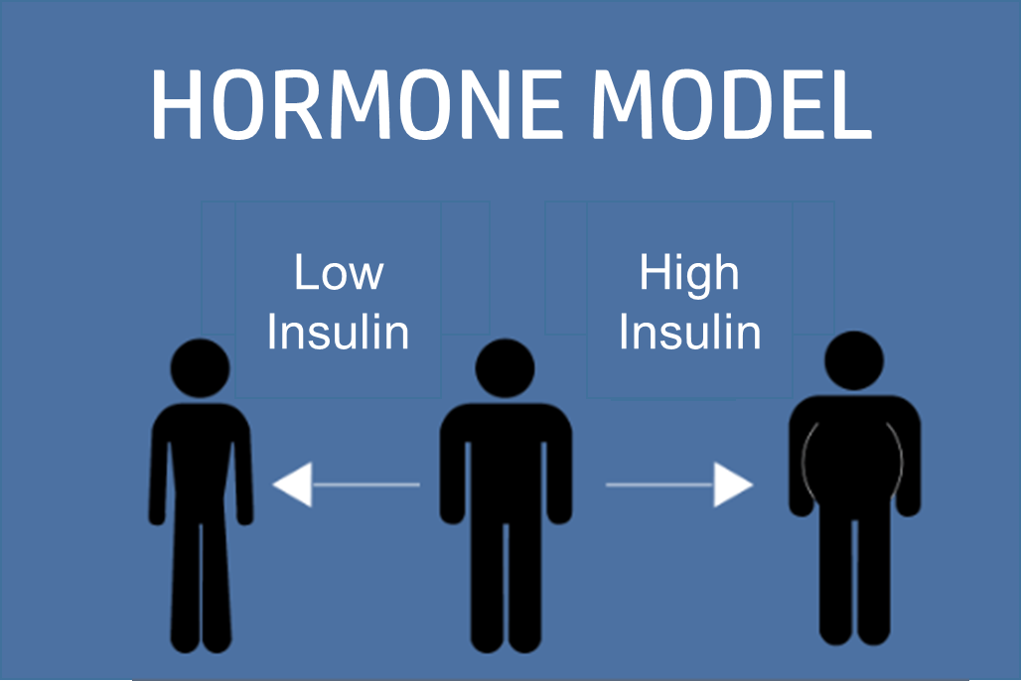
Hormone Theory: The accumulation of fat mass is a result of dietary carbohydrates leading to elevated insulin levels which shifts metabolism into fat storage and away from fat oxidation.

Slide 14
Keto vs Low Calorie
Study of 17 overweight or obese men. They all followed high carb for 4 weeks then followed up with either reduce calorie or keto.
Reduced calorie group lost 0.8kg (with 0.5 kg from body fat)
Keto diet lost 1.6 Kg but only 0.2kg from body fat and that was in a 15 day period. The keto diet did show lower insulin levels.
The keto diet is beneficial for seizure disorders and some brain tumors.
There is no evidence that it has a benefit over low calorie diet but some people with automatically reduce calories with Keto because of the lower processed sugar laden food.

Slide 15
Paleo Diet
Hunter Gather Diet
Allowable food: Unprocessed animal and plants including meat, fish, eggs, vegetables, fruits, nuts, and seeds.
Eliminate: Sugar, dairy and grains

Slide 16
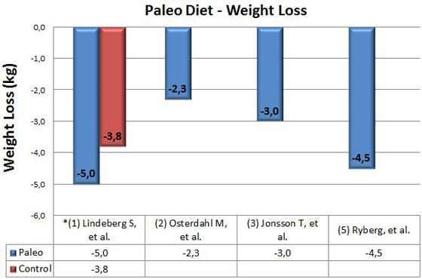
Weight Loss and Waist Circumference
This graph shows the amount of weight loss in the studies.
* In Lindeberg, et al (1), the weight loss difference was not statistically significant.
I did not include Frassetto, et al (4) because they controlled for calories to make sure that the participants didn't lose weight.
There are several things worth mentioning here:
None of the participants were instructed to restrict calories, but they spontaneously reduced calorie intake by 300-900 calories per day.
The participants ended up eating much fewer carbs and more protein, compared to what they were eating before.
The graph below shows the effect on waist circumference (a marker for the harmful visceral fat around the organs).

Slide 17
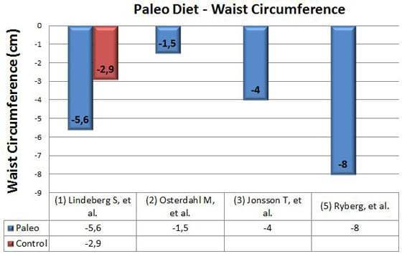
The graph above shows the effect on waist circumference (a marker for the harmful visceral fat around the organs).
The studies had statistically significant reductions in waist circumference, which should translate to a reduced risk of diseases like diabetes and cardiovascular disease.
It is worth mentioning again that Ryberg, et al (5) had an average reduction in liver fat of 47% after 5 weeks on the paleo diet, which is very impressive.

Slide 18
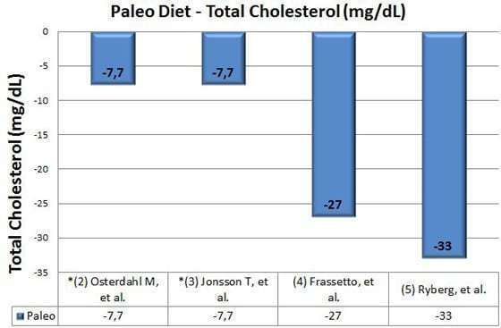
Cholesterol and Triglycerides
Four of the studies (2-5) reported changes in Total Cholesterol, LDL Cholesterol, HDL Cholesterol and Blood Triglycerides:
There were reductions in Total Cholesterol in two studies (4, 5), but the difference was not statistically significant in the other two (2, 3).

Slide 19
Blood Sugar and Insulin Levels
All of the studies looked at markers of blood sugar levels and insulin sensitivity.
However, they used many different methods, so there is no way to compare the results in a graph.
It is clear from looking at the studies that the paleo diet does lead to improvements in insulin sensitivity and glycemic control (1, 3, 5), although the results were not always statistically significant (2, 4).

Slide 20
Conclusions
These were small studies with a few number of participants
They were all short duration with the longest being 12 weeks
Switching over to food sources that have not been processed long-term could provide even more improvements.

Slide 21
Mediterranean Diet
The Mediterranean diet is high in monounsaturated fat, principally olive oil, low in saturated fat, high in complex carbohydrates from legumes, and high in fiber, mostly from vegetables and fruits. Total fat may be high (approximately 40% of total energy intake), and the monounsaturated-to-saturated fat ratio should be around 2. The high content of vegetables, fresh fruits, cereals, and olive oil guarantees a high intake of beta-carotene, vitamins C and E, polyphenols, and various important minerals. These key elements have been suggested to be responsible for the beneficial effect of the diet on human health and especially on cardiovascular disease.

Slide 22
Investigators from the Lyon Heart Study (de Lorgeril et al 1999) examining 605 patients aged 55–80 years with previous myocardial infarction found that the benefits of the Mediterranean diet extended to the secondary prevention of cardiovascular disease. Those who followed the Mediterranean diet had 50%–70% lower risk of recurrent heart disease compared with those who followed a diet similar to the American Heart Association (AHA) Step–I diet. Their findings illustrate the potential importance of the Mediterranean dietary pattern compared with other recommended diets, within the context of a Step–I (ie, total fat <30% of total calories, carbohydrates >55% of total calories, protein about 15% of total calories and cholesterol <300 mg/dl).

Slide 23
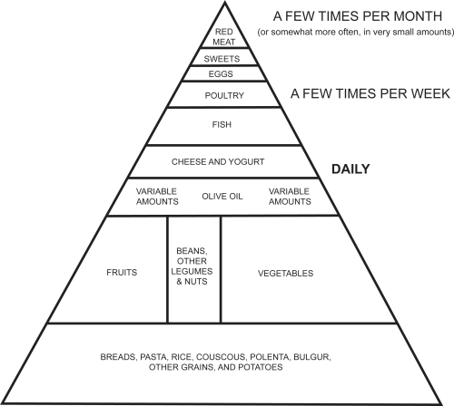

Slide 24
The traditional “Mediterranean diet” refers to specific food consumption patterns typical of some Mediterranean regions in the early 1960s, such as Crete, other parts of Greece, Spain, and southern Italy. In general, the traditional Mediterranean diet is characterized by a diet high in fruits, vegetables, cereals, potatoes, poultry, beans, nuts, lean fish, dairy products, small quantities of red meat, moderate alcohol consumption, and olive oil as an important fat source. In particular, this dietary pattern consists of agents, as follows:
Daily consumption: non-refined cereals and products (whole grain bread, pasta, brown rice, etc), vegetables (2–3 servings/day), fruits (6 servings/day), olive oil (as the main added lipid) and dairy products (1–2 servings/day):
Weekly consumption: fish (4–5 servings/week), poultry (3–4 servings/week), olives, pulses, and nuts (3 servings/week), potatoes, eggs, and sweets (3–4 servings/week):
Monthly consumption: red meat and meat products (4–5 servings/month).
The Mediterranean diet also is characterized by moderate consumption of red or white wine (ie, more than 100–200 mL per day) and almost always during meals. Although the intake of milk is moderate, the consumption of cheese and yogurt is high. Feta cheese is added regularly to salads and to accompany vegetable stews. This traditional dietary pattern is illustrated in a diet-pyramid .

Slide 25
Whole 30
The rules
Eat Real Food: Eat moderate portions of meat, seafood, and eggs; lots of vegetables; some fruit, plenty of natural fats; and herbs, spices and seasonings. Eat foods with very few ingredients, all pronounceable ingredients or better yet, no ingredients listed at all because they’re whole and unprocessed.
No sugar or artificial sweeteners
No Alcohol
No grains
No legumes
No dairy
No carrageenan, Msg or sulfites
Do not consumed bake goods, junk food or treats with approved ingredients

Slide 26
Purpose of the Whole 30
Do not weigh for 30 days
Do not count calories
Learning to eat unprocessed food and truly nourish your body
Take charge and make choices about food instead of eating blindly.
Learn by reintroduction after the 30 days what food makes you feel good and what foods really are not helping you to function better.

Slide 27
Summary
The common denominator in these new diet trends are getting away from counting calories and eating more unprocessed foods
Introducing foods into your diet based on the what type of nutrients they provide that can improve your health.
When we start Eating to Live instead of Living to Eat we will be making better choices.

Slide 28
Nutrition and Your ITP
Obtain your baseline information such as weight, BMI, and dietary tool such as rate your plate.
Utilize your dietician if possible for further instructions and if not possible find ways to incorporate diet education into your exercise sessions.
Provide patients with weekly recipes especially ones that can increase their intake of vegetables because that is an area that is usually lacking.
Make your message clear and consistent: Fruits, vegetables, lean protein, nuts and seeds should make up the majority of the diet.
The ingredients are more important then the numbers on the package
Reevaluate your patients by periodic weigh ins and have them repeat the dietary tool when they finish to see if their habits have changed.

Slide 29
Impact of dietary shift to higher-antioxidant foods in COPD: a randomised trial
E. Keranis, D. Makris, P. Rodopoulou, H. Martinou, G. Papamakarios, Z. Daniil, E. Zintzaras, K.I. Gourgoulianis
European Respiratory Journal Oct 2010, 36 (4) 774-780; DOI: 10.1183/09031936.00113809
sciencedrivennutrition.com/the-ketogenic-diet/
://www.healthline.com/nutrition/5-studies-on-the-paleo-diet#section5
https://www.ncbi.nlm.nih.gov/pmc/articles/PMC2684076/

