Slide 2
Quality patient care is at the core of all we do. Value-based care is delivering the best quality patient care with regards to the cost of that care through data-driven analysis and service improvement. The Value-based care Initiative provides resources which assist cardiac & pulmonary rehabilitation professionals to:
Assign accountability.
Target efficiencies.
Strategize operational transformation.
Restructure the care delivery model.
Implement effective technology solutions in management.
Ultimately improve the patient and practitioner experience.

Slide 3
AACVPR’s partnership with Million Hearts, a branch of the Center for Disease Control, has resulted in the new Cardiac Rehabilitation Change Package, released at the 33rd AACVPR Annual Meeting.

Slide 4
What is the Cardiac Rehab Change Package
Listing of Process Improvements
Composed of:
Change Concepts
Key Drivers that lead to development of more specific ideas
Change Ideas
Actionable, specific ideas or strategies for changing a process
Tools & Resources
What you use to impact the process

Slide 5
Focus Areas
Systems Change
Referrals
Enrollment & Participation
Adherence

Slide 6
Focus Area
Systems Change – Establishing foundations for effective CR utilization
Change Concept – Making CR a Health System Priority
Change Idea - Engage the care team in CR and ensure their buy-in in CR
Tools & Resources
Crucial conversation with Medical Providers & Hospital Administration
Million Hearts – Cardiac Rehab Infographic
CP Rehab: Update to Department Managers

Slide 7
Focus Area
Referrals
Change Concept – Standardize the CR Referral Process
Change Idea – Use Inpatient EHR tools to automate referrals to CR for eligible patients
Tools and Resources – Emory Healthcare: Cardiac Rehab Electronic Referral Process and Communication Tool Presentation

Slide 8
Focus Area
Enrollment & Participation
Change Concept – Improve efficiency of enrollment
Change Idea – Incorporate group orientations
Tools & Resources
AACVPR CR Enrollment Strategy
Group Orientation Process Flowsheet
Welcome to Heart & Vascular and PR PP for Patients

Slide 9
Focus Area
Adherence
Change Concept – Improve Patient Engagement
Change Idea – Connect enrolled patients with a graduate or Phase III participant Patient Ambassador or “sponsor”
Tools and Resources – Miriam Hospital – Patient Ambassador Program

Slide 10
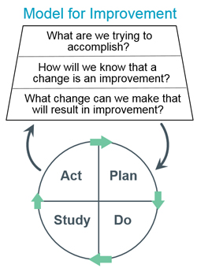

Slide 11
Process Improvement
Plan - Begin by collecting baseline data on a process that you are interested in improving
Do – Test your change ideas on a small scale using a small number of patients, and discuss with clinical staff any identified potential barriers to implementation
Study – Assess success of the implantation of your test
Act – Make needed refinements as you scale up your project to a larger level

