Slide 1
Mechanical Circulatory
Assist Devices
Lisa Dunnivant, BSN, RN, CCRN
April 23, 2026

Slide 2
Learning Objectives
Discuss available mechanical circulatory support devices for home use
Review clinical management for patients with mechanical circulatory support devices
To understand patient care requirements during emergency situations
Notes:
2
The importance of ventricular assist devices with cardiovascular disease

Slide 3
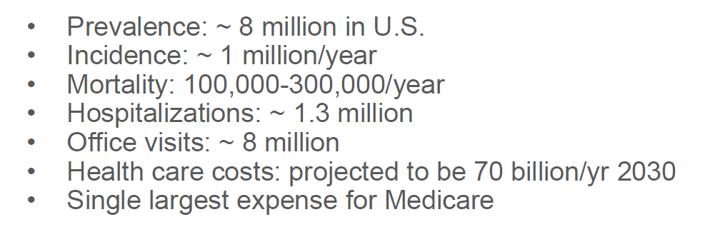

Slide 4
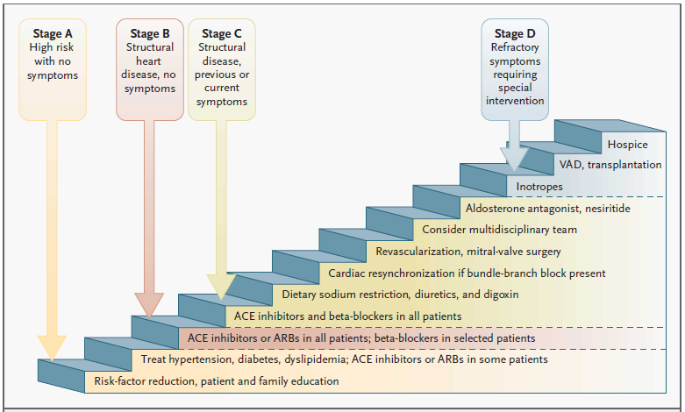
Disease Progression
Jessup, NEJM 2003

Slide 5
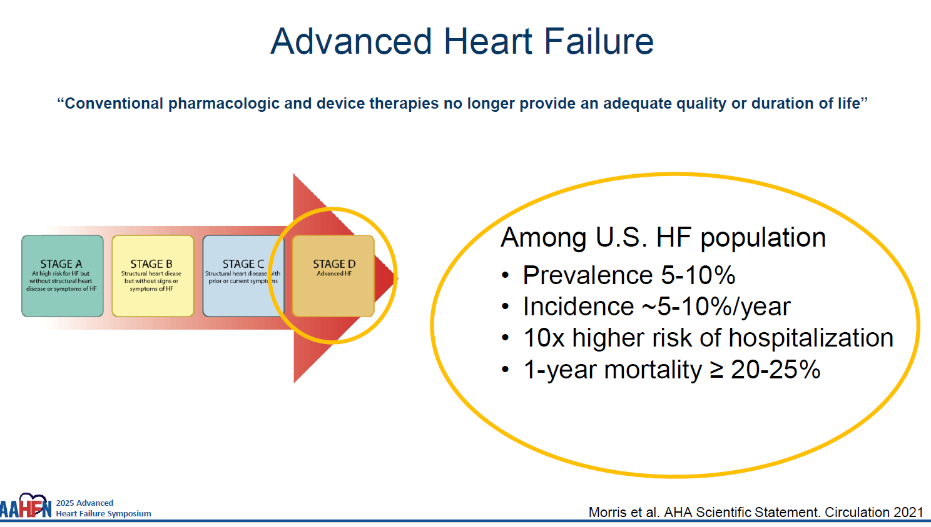

Slide 6
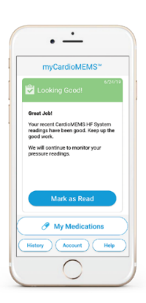
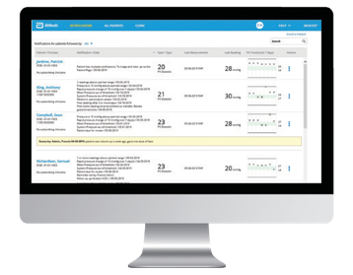
The CardioMEMS™ HF System Provides The Actionable Data You Need To Empower Intelligent Remote Monitoring
The PA sensor is inserted via right heart catheterization.
Patient takes daily sensor reading from the comfort of their home.
Data wirelessly transmitted to Merlin.net™ PCN, a secure website that easily presents PA pressure data to inform proactive treatment modifications.
Clinician reviews data and contacts patient, as necessary.
Notes:
9% of our patients have cardiomems, with this device we have had 50 interventions preventing a readmission (50-70% readmission prevention), we had 7 get admitted and we have 5 compliant and 2 noncompliant pts

Slide 7
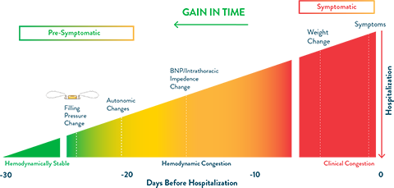
Proactive use of Pulmonary Artery Pressures

Slide 8
2024 Demographics
Financial Class | MCS Patients | IU Health
Managed Care | 26% | 39%
Medicaid/HIP | 34% | 21%
Medicare | 40% | 38%
Other/Special Contract (VA) | 0% | 1%
Uninsured | 0% | 0%
Race | MCS Patients | Indiana
White | 69% | 78%
African American | 31% | 9%
Asian | 0% | 3%
Other | 0% | 10%
Age | MCS Patients | Indiana
20-44 | 20% | 33%
45-64 | 54% | 25%
65-older | 26% | 16%
Gender | MCS Patients | Indiana
Female | 29% | 50%
Male | 71% | 50%
    Data Source: MCCM, Medical Records, and STATS Indiana
    MCS patients LVAD implants for 2024
Notes:
For 2024 implants

Slide 9

Current Patients
2025

Slide 10
Indications for Use
Bridge to Recovery/Decision (BTR/BTD)
    Post cardiotomy Shock
    Acute MI
    Cardiac Disorders such as Viral Myocarditis
Bridge to Transplant (BTT)
    Cardiomyopathies
Destination Therapy (DT)– improve quality of life when not a transplant candidate
Notes:
10
Cardiomyopathies – familial, congenital, ischemic, idiopathic – viral, postpartum
Giant Cell, ameloidosis, adrianmycin

Slide 11
Not everyone can get a VAD!!
Advanced Therapy Evaluation
Clinical inclusion/exclusion criteria
  BTT
  DT
Psychosocial Evaluation
Pre-VAD meeting with the VAD team
  Dependable caregiver support
Presented to Advance Heart Care Board for acceptance for BTT/DT VAD
Notes:
11
11
Many things are evaluated before a patient is able to get a VAD and it is put in front of the Advanced Heart Failure Board. At times the patient is placed on a contract to meet requirements for transplant Letting the potential patient meet an existing VAD patient. Getting acceptance from the board allows a fairness for the program

Slide 12
Contraindications for VAD
Active Infection
Multi-organ failure
History of noncompliance
No caregiver support
Central Nervous System damage before or during operative procedure – including cognitive impairment
Right heart failure and arrhythmias

Slide 13
Defining a Mechanical Circulatory
Support Device (MCSD)
A MCSD is designed to circulate the blood
in the body when the patient’s heart is
unable.
Types of Mechanical Circulatory Support Devices
  HeartMate 2/3
  HeartWare
Notes:
13
I will begin this lecture by discussing
670,000 new cases of heart failure are diagnosed in the US every year
277,000 deaths are caused by heart failure each year
Approx 2200 hundred transplants have been done a year nation wide- number has stayed constant for the past eleven years
Approx 3000 people are waiting, the wait time can be months to years
Destination/Bridge- we have 60 patients at home

Slide 14
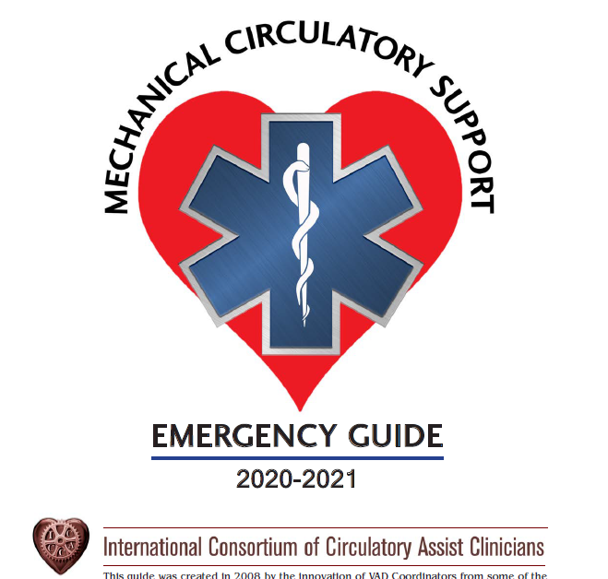
Types of MCSD’s
HeartMate 2
HeartMate 3
HeartWare
Notes:
14
Preload and afterload, early notification is best

Slide 15
Comparison of Pulsatile and Continuous Flow
Continuous
Pulsatile
(Both have average flow between 4-5 L/min)

Slide 16
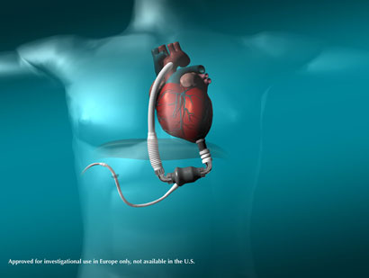
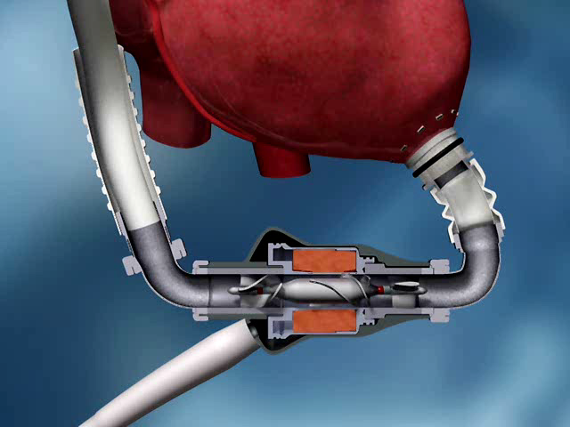
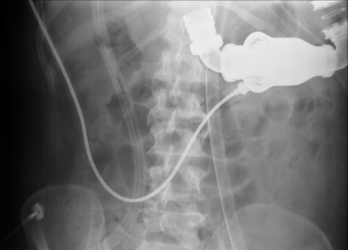
HeartMate 2
Left ventricular assist device only
Long term use
Axial flow – continuous flow
Bridge to transplant
Destination therapy
Notes:
16
(BSA >1.5 4.8ft and 132 lbs )(BSA >1.2 5ft 2 inches and 96lbs)

Slide 17
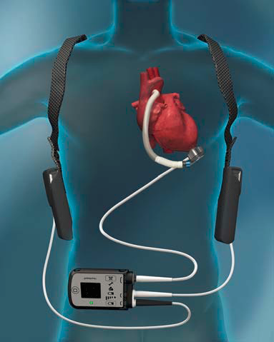
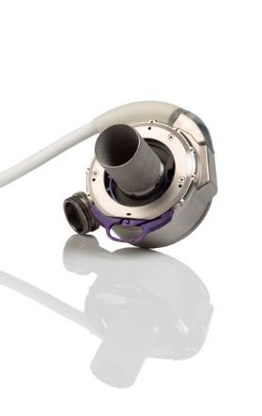
HeartMate 3
Left ventricular assist device only
Long term use
Centrifugal pump - continuous flow
Bridge to transplant
Destination therapy

Slide 18
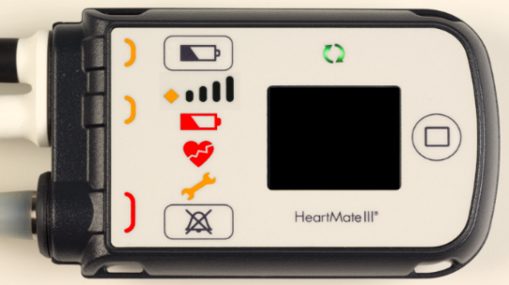
HeartMate System Controller
Alarm Indicators
Power Cable Disconnected Advisory
Low Battery Advisory
Low Battery Hazard
The system controller will alarm if it detects an issue in the operation of the pump, if the patient is experiencing alarms, contact the Implant Center for LVAS-specific emergency instructions
Driveline Disconnected Hazard Alarm
Advisory Alarm
Hazard Alarm
10001926
CAUTION – Investigational device. Limited by US Federal law to investigational
ClinicalTrials.gov Identifier: NCT02224755

Slide 19
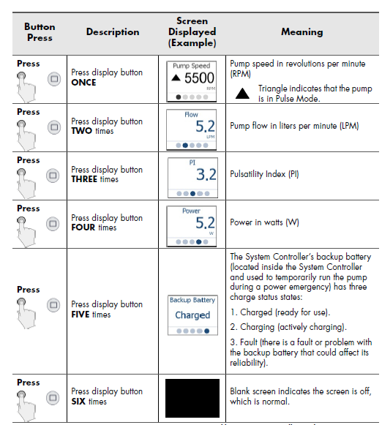
HeartMate 3 System Controller
Viewing Pump and System Parameters
Press the Display Button to view pump parameters and backup battery charge status on the display screen.
*
Notes:
IFU pg 53: Viewing information about the pump is useful when recording daily values or trying to resolve system problems on the telephone. When the System Controller is running, the user interface can display the following information about current system operations:
Speed in rpm
Mode (indicated as Pulse Mode by triangle symbol)
Flow in liters per minute
Pulsatility Index (abbreviated as “PI” on the screen)
Power in watts
Charge status of the System Controller’s 11 Volt Lithium-Ion backup battery
To view information on the user interface screen, press and release the display button. Each push of the display button brings up a new screen. Each screen illuminates for 15 seconds before it goes black, unless another button is pushed. The screens are always displayed in the same order, starting with the first (Speed) screen. A dot at the bottom of each screen provides navigational information about which of the five screens is in view.

Slide 20
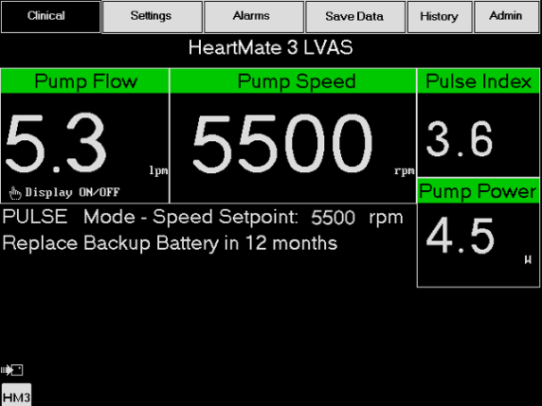
Pump Parameters
HeartMate 3™ LEFT VENTRICULAR ASSIST SYSTEM THEORY OF OPERATION
  Speed
  Flow
  Power
  Pulsatility Index
IMPORTANT!
One single pump parameter is not a surrogate
for monitoring the overall clinical status of the patient. Any change in parameters should
be evaluated with all clinical considerations
in mind.

Slide 21
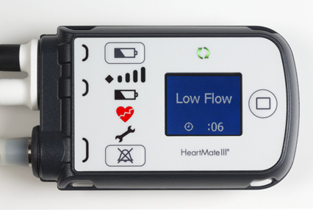
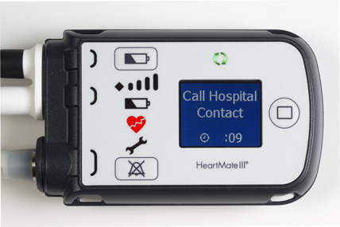
Low Flow (Hazard Alarm)
Alarm Means:
Pump flow is less than 2.5 lpm
Constant audio tone
Silence is 2 minutes
Action:
Connect to a working power source
Check connections (Driveline, Modular cable connection, Power, and AC), and push Controller buttons
Evaluate the patient for causes
Notes:
IFU pg 385
Behavior and appearance:
Flashing Red Heart ( ) on the user interface.
“Call Hospital Contact” and “Low Flow” alternate on the screen.
Alarm tone: Constant tone.
Alarm silence: 2 minutes or until a new hazard alarm occurs
System Monitor alarm active: LOW FLOW
Potential causes
Decreased preload (right heart failure, tamponade, hypovolemia, bleeding, etc.)
Obstruction of pump inflow or outflow
Systemic hypertension
Pump off or driveline disconnected
To resolve alarm:
Ensure the Driveline is connected to the System Controller.
Ensure that a power source is connected to the System Controller.
Clinically evaluate patient – ECHO to assess RV, LV function, inlet cannula obstruction
Treat underlying cause

Slide 22
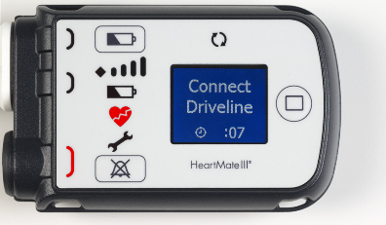
Driveline Disconnected (Hazard Alarm)
Alarm Means:
The Driveline is disconnected from the System Controller
Constant audio tone
Silence is 2 minutes
Action:
Immediately connect the driveline to the System Controller
Check Modular cable connector for a complete connection
Exchange controller
Important! If controller stops alarming Connect Driveline, but Low Speed and Low Flow alarms persist and the pump does not ramp up to the set speed, disconnect and reconnect the driveline.
Notes:
IFU pg 384
Behavior and appearance
Flashing Red Heart on the user interface.
Flashing red light near Driveline connector.
“Connect Driveline” flashes on the screen.
Green “pump running” symbol is off.
Alarm tone: Constant tone.
Alarm silence: 2 minutes or until a new hazard alarm occurs.
System Monitor alarm active: DRIVELINE DISCONNECTED
Action
Immediately reconnect the Driveline to System Controller and move the Driveline Safety Lock on the System Controller to the locked position.
If alarm persists after reconnecting the Driveline, press any button on the System Controller to attempt pump start. Also, check that the Modular In-Line Connector is secure. Otherwise, check if the fixed speed setting is below 4000 rpm AND the System Controller’s backup battery is not installed. Under these conditions, the pump can only be started from the System Monitor’s Clinical or Settings screen by pressing the Pump Start button
If Driveline is connected and alarm persists, replace System Controller with a backup System Controller.

Slide 23
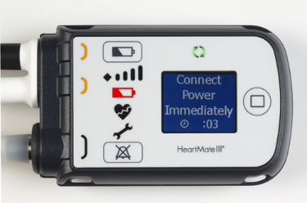

No External Power (Hazard Alarm)
Alarm Means:
The System Controller is not receiving power from either power cable. The pump is being powered by the System Controller’s 11 Volt Lithium-Ion backup battery
Constant audio tone
Silence is 2 minutes
Action:
Immediately connect both power cables to a working power source (14 V Li-Ion battery, Power Module, or Mobile Power Unit)
Notes:
IFU pg 385
Behavior and appearance:
Flashing Red Battery on the user interface.
“Connect Power Immediately” and Backup Battery graphic alternate on the screen.
Yellow light near the black power cable connector is flashing.
Yellow light near the white power cable connector is flashing.
Alarm tone: Constant tone.
Alarm silence: 2 minutes or until a new hazard alarm occurs.
System Monitor alarm active: NO EXTERNAL POWER
To resolve alarm:
Immediately connect to a functioning Power Module, Mobile Power Unit, or two fully-charged HeartMate 14 Volt Lithium-Ion batteries to ensure the pump does not stop.
The 11 Volt Lithium-Ion backup battery inside the System Controller provides power to the pump for at least 15 minutes when fully charged if the main power source is disconnected or fails.
IMPORTANT! If external power is not restored, the pump gradually slows to the low speed limit to save power in an effort to prevent the pump from stopping. When adequate power is supplied, the pump reverts to the previous speed and the red battery alarm clears.

Slide 24
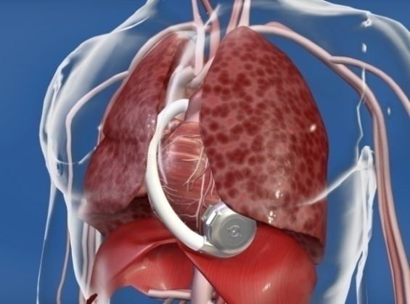
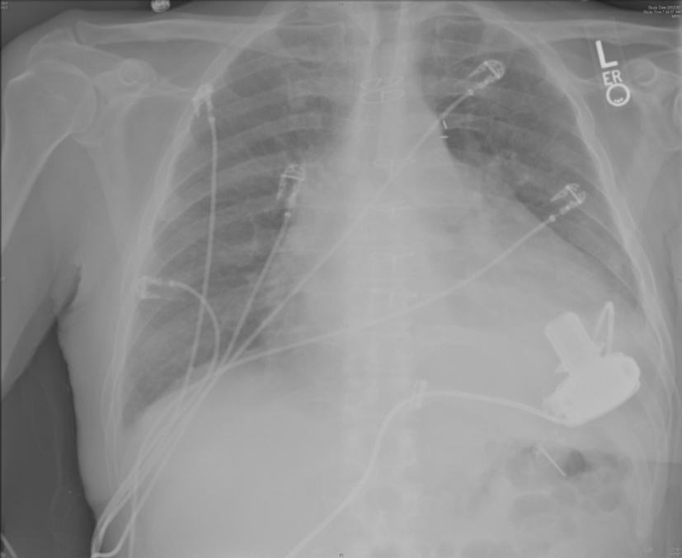
HeartWare
Left ventricular assist device only
Long term use
Centrifugal pump - continuous flow
Bridge to transplant
Destination therapy

Slide 25
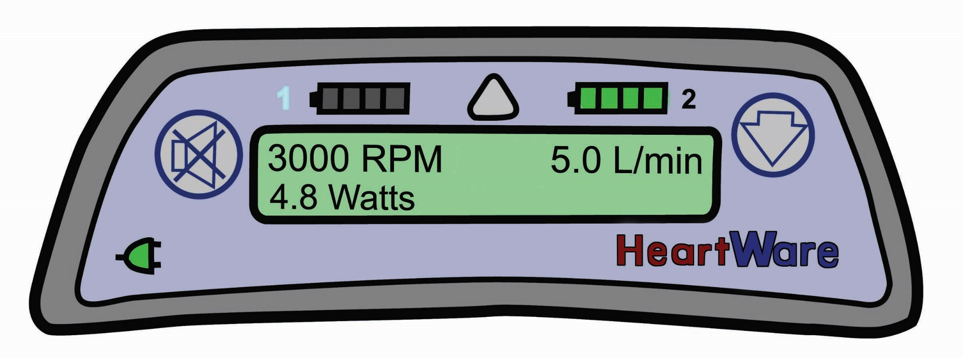
HeartWare® Controller Display
Battery Indicator 2
Battery Indicator 1
Alarm Indicator
Power Source 2
Power Source 1
Alarm
Mute Button
Controller Display
AC/DC Indicator
Scroll Button

Slide 26
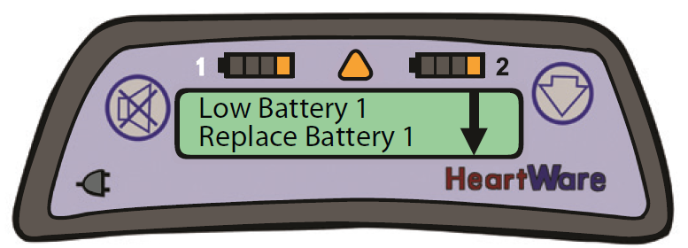
HVAD® Controller: Alarm Indicator & Mute Button
Low Priority: Solid Yellow
Medium Priority: Flashing Yellow
High Priority: Flashing Red
*as shown
Alarm Indicator Symbol
Alarm Mute Button

Slide 27
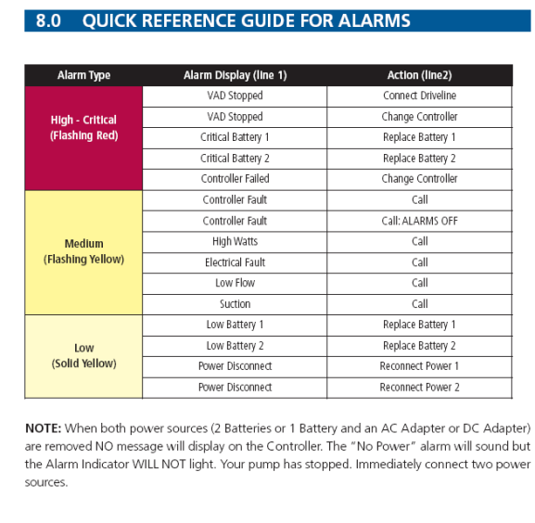
Alarm Guide

Slide 28

Blood Pressure Assessment¹
Continuous flow device
It is recommended to use a Doppler to obtain an accurate blood pressure
Place the blood pressure cuff on the upper arm and apply transmission gel to the skin over the brachial artery
Position the probe over the artery until pulse is heard. Keep the pressure light enough so that the artery is
not compressed
Inflate the blood pressure cuff until the arterial pulse is no longer audible
Slowly deflate the cuff until the first sound can be heard
Document this single number as the blood pressure
    Recommended range for HeartMate and Heartware patients is
    60-90 mmHg, not to exceed 90 mmHg
    Review patient’s history log to assure Doppler pressure is not >90 mmHg
1. Clinical Management of Continuous-flow LVADs in Heart Failure. JHLT. 2010:1-39.
10001926

Slide 29
Physiologic Management
Optimize preload and afterload and you will optimize the pump output

Slide 30

Physiologic Effects of Continuous Flow VADs
Continuous flow means weak or no pulse despite adequate blood supply.
Blood pressure is nonpulsatile: use MAP 60-90
Cardiac rhythm may not correlate with physiologic presentation: Afib, VT
Many of these patients will have a pacemaker/ICD.
Anticoagulation increases risk of bleeding complications INR 2.0-3.0(trauma, head injury, GI)
VAD patients require significant hydration - 2 Liters/daily

Slide 31

Special Considerations for Cardiac Rehab
No crunches
No bending at waist/twisting
No lifting over 20 pounds forever
5-7 pounds axillary equipment
No contact sports
Avoid driveline exit site trauma
Make sure patient is hydrated!
Max heart rate is variable but lower than a healthy person of the same age
  Very individualized, determined by assessment or how they feel
  Evaluate trends, patient, and discuss with team
Notes:
Movement of driveline is #1 cause of infection post implant, want to keep driveline and exit site as immobile as possible! Avoid dropping of any equipment or tugging on driveline site, everything should always be well secured in patient vest/bag/whatever they use. Adequate preload is key.

Slide 32

Psychosocial needs
Body image issues and new equipment to carry
Depression/anxiety for patient and caregivers
Grief/learning a new normal
Chronic illness
Significantly increased risk for hazards post implant
PTSD from shocks while awake, hospitalization, etc. (afraid to go to sleep)
Be a listening ear for these patients
Patients don’t want to feel like a burden to caregivers
Notify coordinators for things that are unusual!
  High/low PI, high wattage, speed decreases, low flows
  Increased depression/missed appointments
  Signs of infection
Notes:
LVAD is a huge lifestyle change for both patient and their caregiving team, and psychosocial issues post VAD are extremely common. Be alert and on the lookout for signs of depression and anxiety in patients (being withdrawn, quieter than usual, avoiding eye contact, not engaging, etc). These patients may also not have a lot of other support in their life. patients with psychosocial risk remained at significantly increased hazards for device-related infection, gastrointestinal bleeding, pump thrombosis, and hospital readmission compared to those without psychosocial risk.
Studies do find that quality of life improves after LVAD.
DeFilippis EM, Breathett K, Donald EM, Nakagawa S, Takeda K, Takayama H, et al. Psychosocial risk and its association with outcomes in continuous-flow left ventricular assist device patients. Circ Heart Fail 2020;13:e006910. - PMC - PubMed

Slide 33
Emergency Situations
Assess patient and VAD monitor
OK to intubate, defibrillate, and give medications
If need to defibrillate NO disconnection required
Can do chest compressions if you can’t get pump running
CALL 911 and VAD team
Notes:
Look for green arrows in circle above display screen on HM3! Listen with stethoscope

Slide 34



ER and EMS Training
2013: Initiated statewide EMS guide for all MCS implanting centers including contact numbers for each facility to streamline care
Notify local ER and EMS
Quarterly webinar training with ER and EMS prior to discharge with new implant
Continue to develop a distribution list of EMS facilities and ERs as a resource to educate the community

Slide 35
Webinar Education
Training Easily Accessible
  We could initiate webinar for your area and record to forward to entire staff
  Ability to participate with any computer. “Show & tell with the devices”
  Case studies shared for review and discussion
Post-Presentation Resources
  PowerPoint and EMS field guide available
  Educational presentations are recorded and available via email link for those who could not join live
  IF INTERESTED IN BEING ADDED TO WEBINAR EMAIL: jpickrell@iuhealth.org

Slide 36
COVID and VADs
COVID vaccinations
If patients get COVID we want to try to get them IV infusion
Majority of our patients have had COVID
Encourage patients to get O2 oximeter
Stay hydrated
Frequent communication
We have NOT seen workups for LVAD or advance therapy due to post COVID heart disease

Slide 37
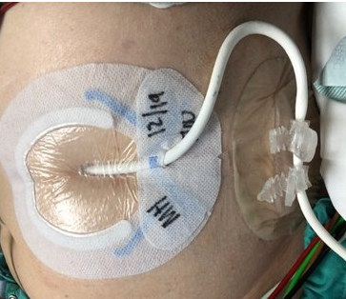
Driveline Care
The driveline will exit on the left or right side of the abdomen, where ingrowth will create a seal around the tubing
The aseptic dressing change is performed by the care provider according to the implanting center policy
The driveline should always be anchored, as breaking the seal will increase the chance of infection
Report any evidence of redness to the VAD Team, as they will likely treat with antibiotics
We do NOT like exercises where they utilize their abdomen muscles, we have seen this cause driveline infection
10001926
1. Clinical Management of Continuous-flow LVADs in Heart Failure. JHLT. 2010:1-39.
Notes:
US-HM2-04150208(1)

Slide 38
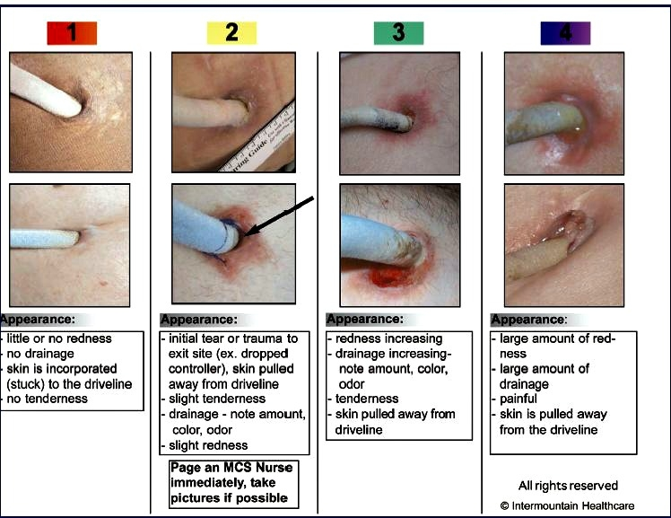
Driveline Exit Site

Slide 39
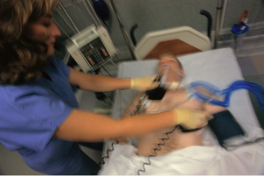
Emergency Care¹
External Defibrillation and Cardioversion
  Do not stop the pump
  Cardiac Arrest and Chest Compressions
    Use clinical judgment when deciding to perform compressions
    Potential risks: Disruption of outflow graft & left ventricular apex anastomosis
    Contact Implanting Center for direction when possible
  Special Considerations
    May not be able to obtain cuff pressure
    All ACLS drugs may be given
    Any emergency mode of transportation is ok; patients are permitted to fly
    Be sure to bring ALL of the patient’s equipment with them
    Allow care provider to remain with the patient
  ECG
    HeartMate II and Heartware: Pump does not affect ECG
    HeartMate 3: May create electromagnetic interference with ECG monitoring.
    Adjustment of ECG lead placement may reduce the level of interference.
1. Clinical Management of Continuous-flow LVADs in Heart Failure. JHLT. 2010:1-39.
Notes:
Warning: In the event that the LVAD stops operating, retrograde flow may occur; and, if non-circulating blood is in the pump for more than a few minutes (depending on the coagulation status of the patient), there is a risk of stroke or thromboembolism should the device be restarted

Slide 40
What should the patient have with them at all times or in transport???
Caregivers are excellent resources
Bring their back up bag – spare controller, batteries, troubleshooting guide
Bring their log files to review their trends at home
Consider bringing their wall adapter with heartware but not required

Slide 41
Typical Issues for Outpatient LVAD Patients
Hypovolemia “Suckdown”
Blood pressure – maintaining MAP <90 but assessing your patient (Low Flow alarms)
Heart Rate – majority of patients have ICD
Right Heart Failure (often rhythm-related)
Bleeding issues related to anticoagulation therapy or from the pump itself; AVMs in their GI system, or stroke
Infection (may be unrelated to device, exit site, bacteremia, dental work, simple scrapes)
Connections – Power and Driveline
Pump Complications (pump clot, driveline fracture, cable damage)

Slide 42
Case Studies

Slide 43

Case # 1
56 yo white male with HeartMate 2 LVAD is biking when he starts to c/o fatigue, intermittent lightheadedness.
During assessment patient becomes unresponsive with red heart continuous tone alarm
  WHAT DO YOU DO?

Slide 44

ASSESS Patient
  Rhythm
  Pocket Controller indicator light
  LISTEN “VAD hum”
  Vital Signs – Doppler MAP
  LOOK – at all connections – driveline and power sources

Slide 45
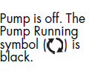
ASSESS Patient
  Rhythm NSR
  Pocket Controller – indicator light is not on
  LISTEN “VAD hum” NOT PRESENT
  Vital Signs – Doppler MAP NO DOPPLER FLOW
  LOOK – at all connections – driveline and power sources EVERYTHING IS CONNECTED
  WHAT NEXT –Utilize field guide - if system controller has not been changed then change system controller, you should be in contact with implanting VAD facility, ACLS – intubate, compressions and medications as needed
  Concern: if VAD has stopped for any length of time about restarting for clot-but ALWAYS attempt to restart the pump if it isn’t running.

Slide 46
VAD Malfunction
  When controller changed, pump DID restart
  Keep patient on battery until assessment at implanting center can be completed
  MAP 80, pulse present
  Patient alert and oriented, extubated few hours later
  Patient found to have a driveline fracture and pump replaced

Slide 47
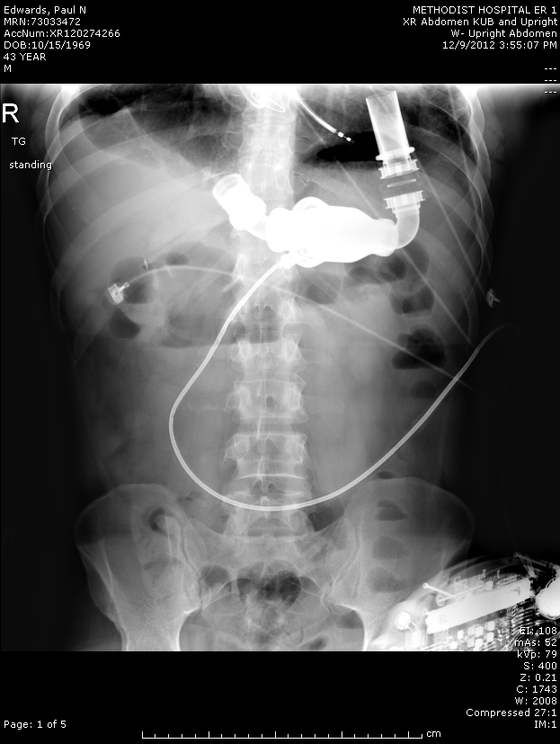
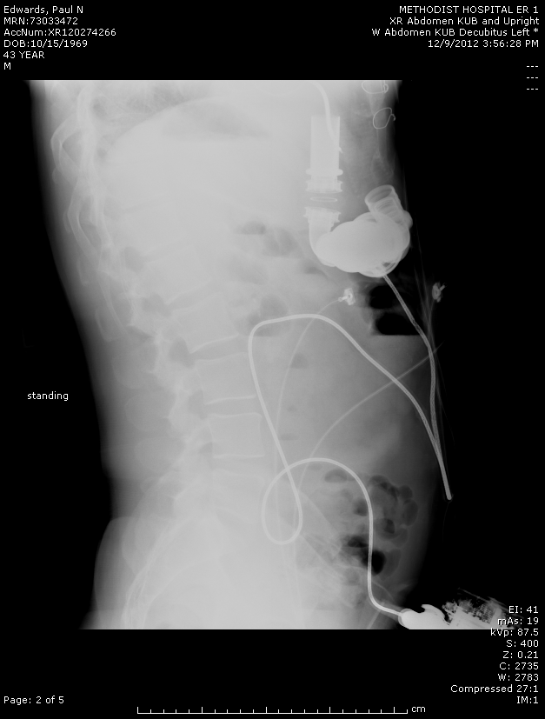

Slide 48
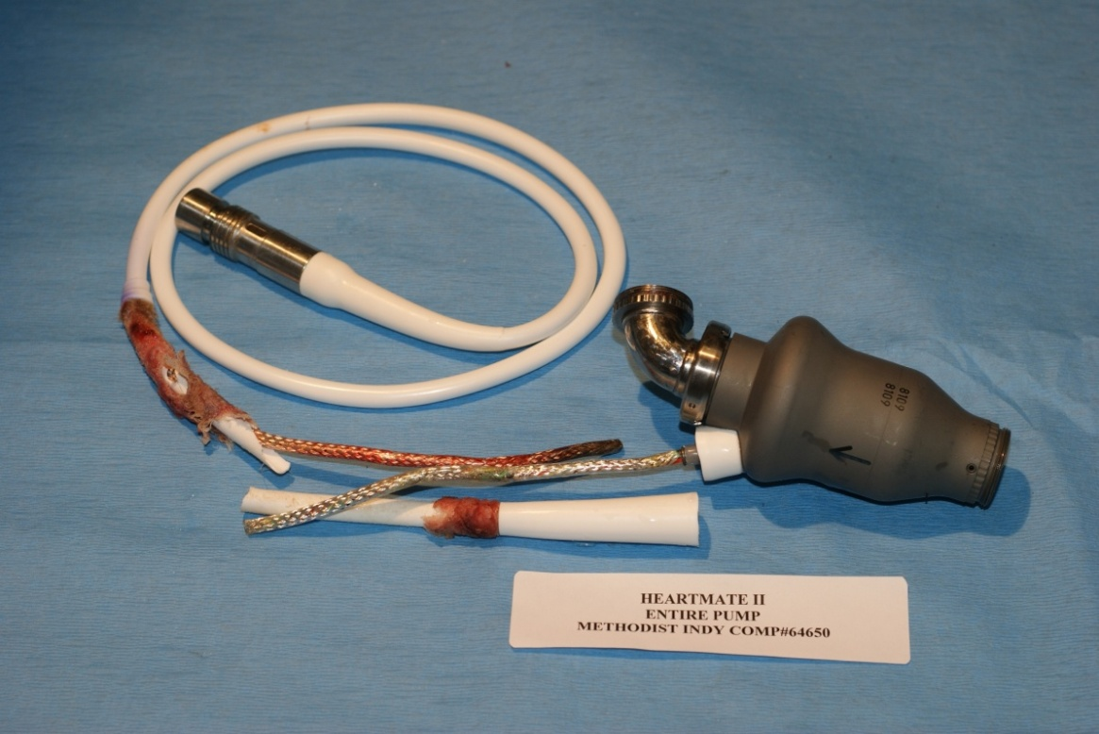
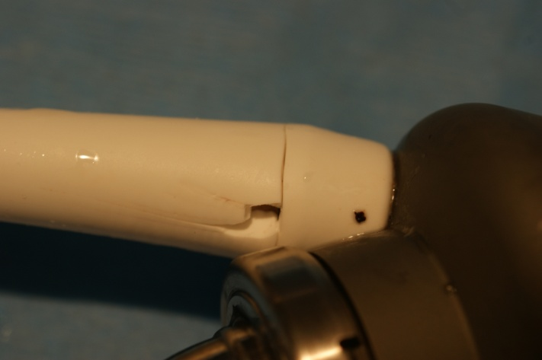
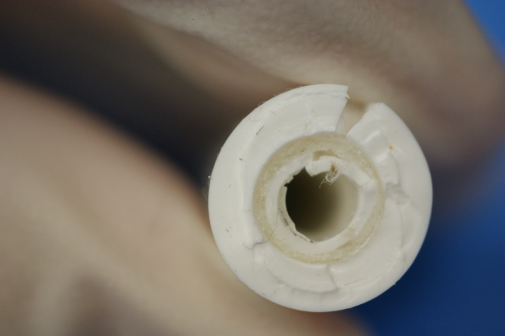

Slide 49
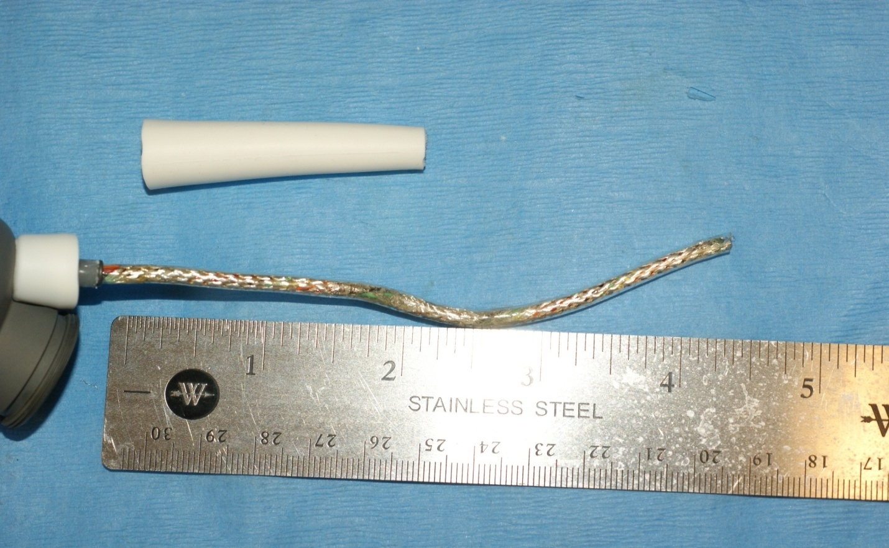
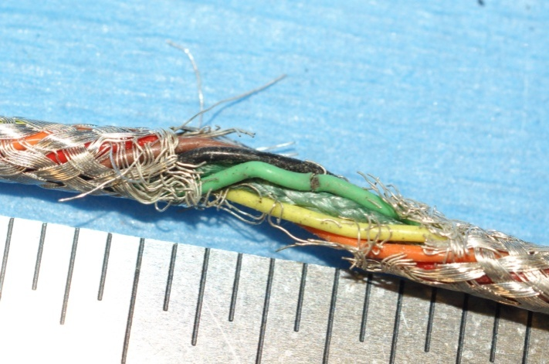
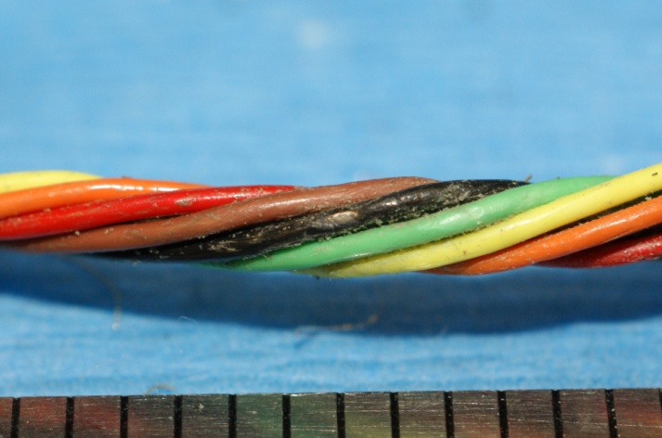

Slide 50
Case #2
66 yo white male with idiopathic cardiomyopathy Heartmate 3 LVAD. Initial VAD numbers RPMs 5200 Flow 4.1 PI 4.1 power 3.5. what he typically runs.
Patient was walking on track when VAD alarmed multiple times with low flows and patient is tired and dizzy.
Temperature 36.8, Respirations 12, MAP 70, O2 Sat 94% on room air. VAD RPMs 5200 Flow 3.0 PI 7.0 power 3.5
Awake, alert, audible VAD hum, JVD, mild peripheral edema- patient is talking to you
EKG shows Vfib – call emergency services per your hospital protocol

Slide 51
  WHAT DO YOU DO?
  Patient is stable
  CONTACT IMPLANTING CENTER
  Utilize EMS Field guide
Community Heart and Vascular Hospital: (317) 523-0159
Indiana University Health (Methodist Hospital): (800) 510-2725
Lutheran Hospital: (260) 435-7001
St. Vincent Health: (866) 344-0011

Slide 52

Arrhythmia
Your standard normal treatment for arrhythmia-patient is awake and talking to you
  Defibrillation – unsuccessful initially (SEDATE AS NEEDED)
  Bolus 250mL NS
  Amiodarone 150mg IV load and drip at 1mg/min
  Successful defibrillated at 200 joules
ICD placed at implanting center and patient discharged home within the week

Slide 53
Case #3
58 yo white male with HeartMate 3 LVAD complaining of feeling lightheaded when he arrived for rehab. Initial VAD numbers RPM 5500 Flow 3.0 PI 1.8 Power 3.8
Poor appetite x2 days. Weight is down. Drank 2 glasses of fluid but still feeling poorly.
Temperature 36.6, MAP 65, O2 Sats 98% on room air, alert and oriented, VAD hum present with no alarms
No JVD or peripheral edema

Slide 54
Hypovolemia
Call local Implanting Center if the patient/caregiver has not for guidance to send to ER, see in clinic, get labs or monitor

Slide 55
To Learn More About VADs
www.syncardia.com
www.thoratec.com
www.heartware.com
www.mylvad.com
www.nlm.nih.gov

Slide 56
Questions

Slide 57
Thank You

