Slide 1
Diabetes: Pharmacotherapy, BGM Technology, and Role of the Pharmacist in Diabetes Management
AND
COPD: Review of Inhaled Medication Therapy and Goals for Improving c
Gwen Combs RPh
Melissa Toon RPh
Notes:
<number>

Slide 2
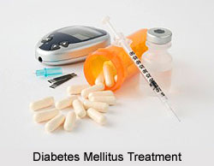
.
Notes:
<number>

Slide 3
Metformin | 1st line therapy unless CRCL <45 ml/min GI Side Effects
SGLT-2 Inhibitors: (Flozins) Invokana (canagliflozin) Farxiga (dapagliflozin) Jardiance (empagliflozin) Steglatro (ertugliflozin) | Weight Loss Renal Dose Adj Required CV & HF Benefit DKA risk (rare in T2D) May slow the rate of renal function decline in pt’s with albuminuria
GIP/GLP-1RA: Mounjaro (tirzepatide) GLP-1RA: Ozempic (semaglutide) Trulicity (dulaglutide) Bydureon (exenatide) | Weekly Injection GI Side Effects and Pancreatitis risk Weight Loss CV Benefits: Ozempic/Victoza/Trulicity Don’t use in combination with DPP-4, similar MOA Personal or family history of medullary thyroid carcinoma (MTC) or in patients with Multiple Endocrine Neoplasia syndrome type 2
Byetta (exenatide) | Twice daily injection
Victoza (liraglutide) Adlyxia (lixisenatide) | Daily Injection
Rybelsus (semaglutide) | Daily Oral
DPP-4 Inhibitors: (Gliptins) Januvia (sitagliptin) Tradjenta (linagliptin) Onglyza (saxagliptin) Nesina (alogliptin) | Don’t use is combination with GLP-1RA, similar MOA Renal dose adjustment required (except Tradjenta) Pancreatitis risk
Notes:
Metformin is very affordable
The other groups are expensive and Insurances may prefer one over another
Insurances may require step therapy or a PA before paying for more expensive meds
<number>

Slide 4
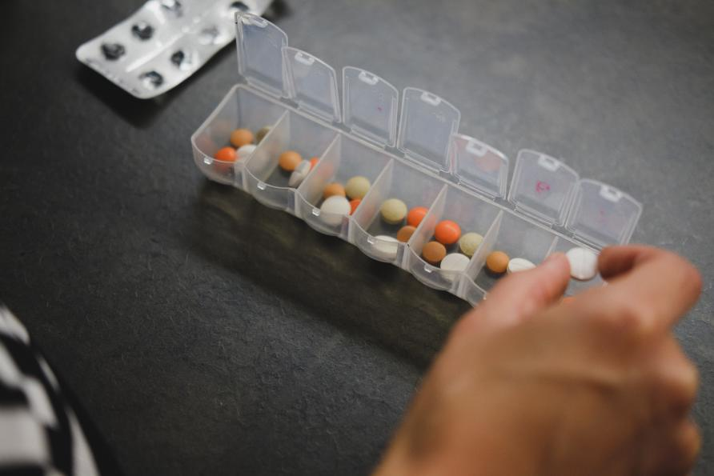
Thiazolidinediones:(TZD) Actos (pioglitazone) Avandia (rosiglitazone) Oseni (alogliptin/pioglitazone) | Weight Gain Fluid Retention- Avoid in HF Risk of Bone Fractures Risk of bladder cancer with prolonged use (>12 months) and higher doses
Sulfonylureas: Glipizide Glyburide Glimepiride | Risk of Hypoglycemia Weight Gain Glyburide- not recommended for use in elderly due to increased hypoglycemia risk Discontinue when prandial insulin started
Notes:
These are very affordable and Insurances normally cover without any issues
<number>

Slide 5
INSULINS
Short Acting Onset in 15-30 minutes Duration 2-6 hours | Fiasp Novolog Apidra Admelog Humalog Humulin R Novolin R
Intermediate Acting Onset in 1-2 hours Duration 12 hours | Humulin N Novolin N
Long Acting Onset in 2-6 hours Duration 24-36 hours | Lantus/Basaglar Levemir Tresiba Toujeo
Inhaled Insulin Onset in 12-15 minutes Duration 3 hours | Afrezza
Notes:
There are generics and biosimilars available now that help reduce the cost
Manufacturers have recently announced a price cap of #35 for certain Insulins
For those with Medicare and those with commercial insurance
<number>

Slide 6
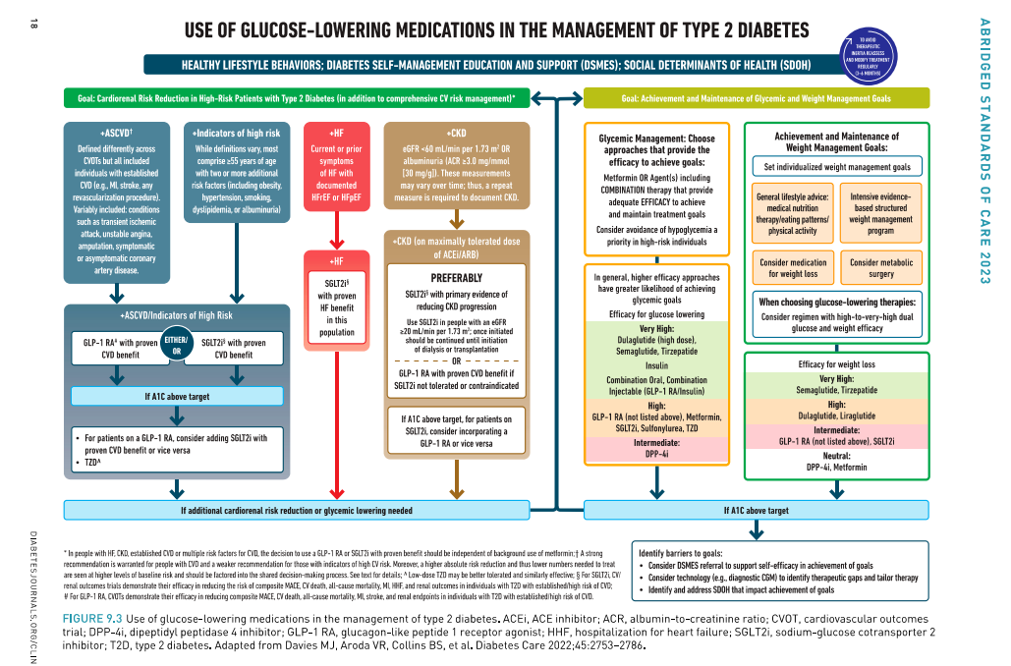

Slide 7
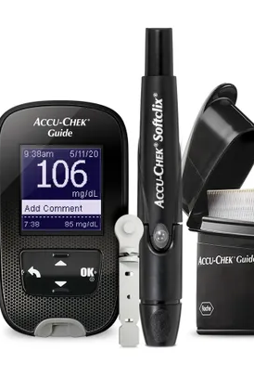
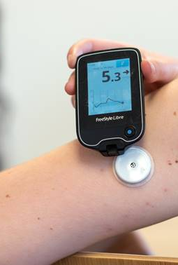
SELF-MONITORING GLUCOSE METERS
BLOOD GLUCOSE METERS and CONTINOUS GLUCOSE MONITORS
Notes:
<number>

Slide 8
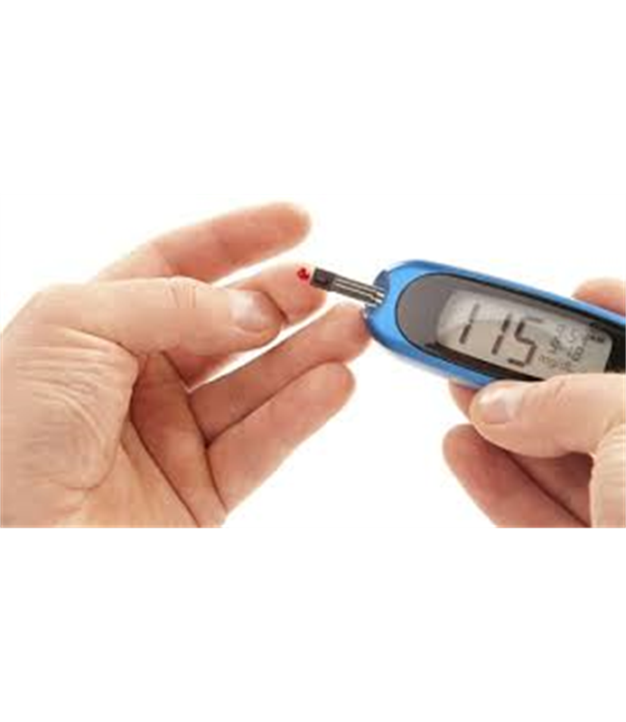
Blood Glucose Meters
Measures your glucose level at that exact time
To see a pattern clearly you would need to check:
  Before every meal and snack
  Two hours after every meal and snack
  At bedtime
  A few times overnight
  Before and after exercise
  Whenever feeling high or low
12 – 30 times a day!
Notes:
<number>

Slide 9
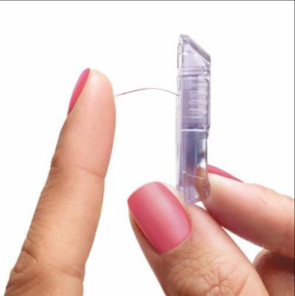
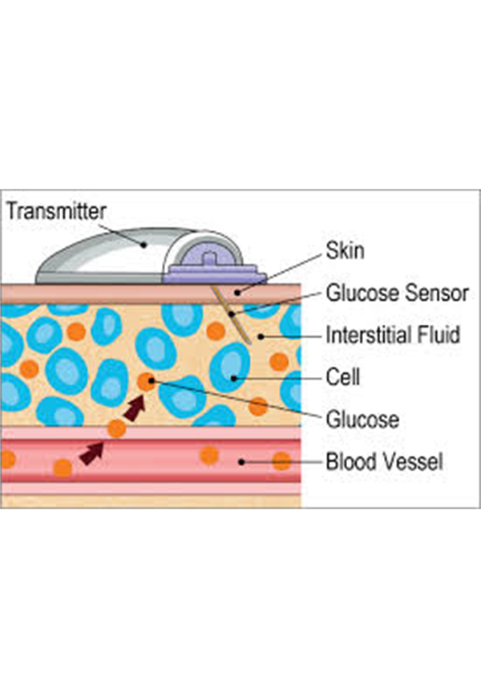
What is Continuous Glucose Monitoring
(CGM)
CGM is a small, wearable device that tracks glucose levels about every 5 minutes, day and night.
Tiny wire sensor is inserted under the skin and measures glucose levels in the subcutaneous fluid.
Connected to a transmitter that sends the data to a monitoring and display device.
Notes:
<number>

Slide 10
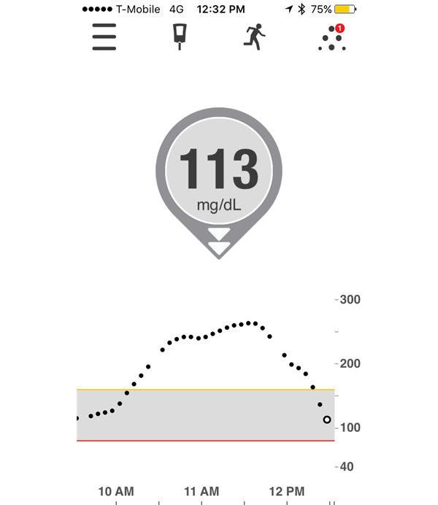
CGM vs Blood Glucose Meters
CGM gives you a fuller picture
  Gives you a CGM reading every few minutes, 24 hours a day.
  Plots data on a trend graph so you can see where glucose levels have been an where they might be heading.
  Trend arrows show where your glucose is headed and how fast it is changing.
  Can set high and low glucose alerts so you know if glucose is headed out of range.
Notes:
Family members can also download an app that allows them to get alerts
<number>

Slide 11
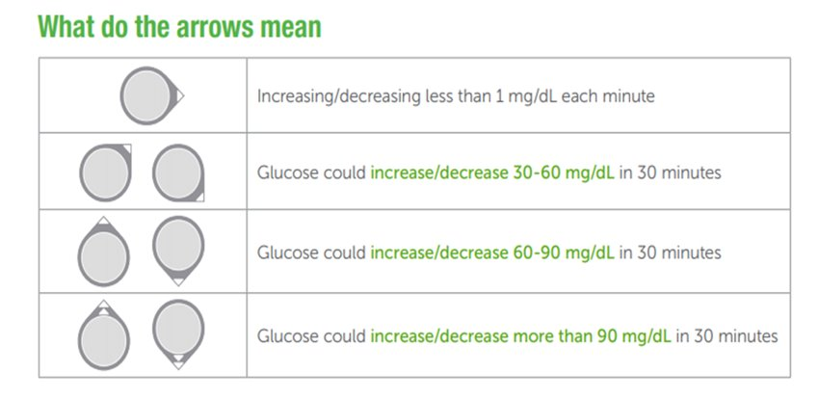
Trend arrows indicate rates of glucose change
(mg/dl per min) and be described as the anticipated glucose change.
Notes:
<number>

Slide 12
CGM reads glucose levels from the interstitial fluid
Blood glucose meters read glucose levels from the blood
CGM vs
Blood Glucose Meter
Readings can be different but are still considered accurate
Usually within 20 % of each other, unless the blood sugar levels are rapidly rising or falling
The CGM and meter will report different glucose levels, this is normal
FDA approved for dosing and treatment decisions
**If the glucose alerts and readings from the CGM do not match symptoms or expectations, use a blood glucose meter to make diabetes treatment decisions.**
Notes:
<number>

Slide 13
Most Common CGMs
 | Freestyle Libre 2/3 | Dexcom G6/G7
Change sensors every 10 days |  | X
Change sensors every 14 days | X
Must scan sensor for reading | X Libre 3 does not
Can use smartphone as reader | X | X
Requires a transmitter *expires every 3 months |  | X *G7 does not
Website to download/upload data | X | X
Accurate glucose readings | X | X
Notes:
Website uploads information from CGM that can be shared with provider and provides reports with trends
For treatment decisions
<number>

Slide 14
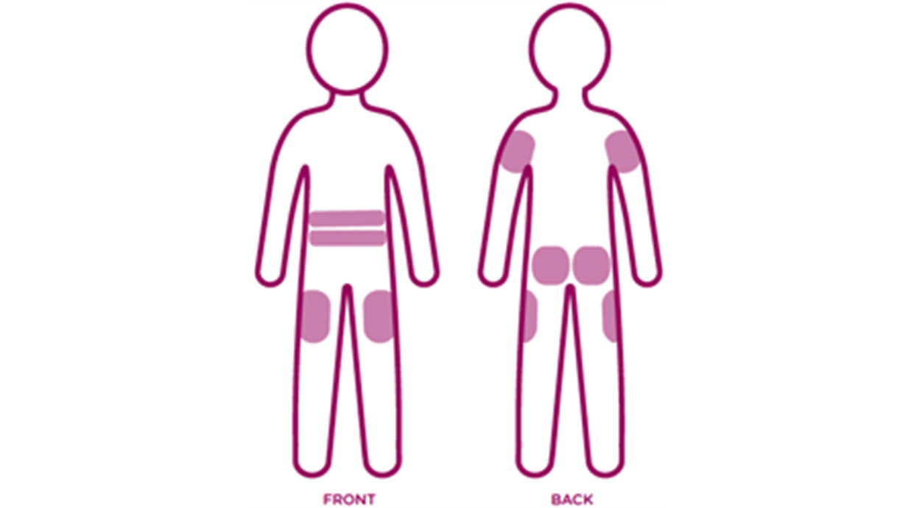
Sites to wear CGM
Notes:
Patient will want to rotate sites to prevent irritation
<number>

Slide 15





Look at trends over several days before making adjustments.
Educational Tips
Avoid "reacting" to the number. See if a pattern develops.
Blood sugars will rise after a meal but as long as the value comes back to the target range by the next meal, no intervention is needed.
Ketone checks only necessary when blood sugar >300 mg/dL for more than 2-3 hours on the trend graph.
Call CGM company for technical concerns and if sensors are not lasting the entire 7-14 day cycle.
Notes:
<number>

Slide 16
How CGMs Improve Diabetes Care
Allows patients to get a complete picture of their blood sugar control
Improves visibility and allows patients and their care teams to make better treatment decisions resulting in improved health outcomes
Ability to alert patients to potential problems, such as high or low blood sugar levels
Improves compliance due to less needle sticks and better portability
Unable to manipulate the data as glucose is continuously monitored so patients can't just take their blood sugar at opportune times
Websites to upload data provide reports and trends to adjust treatments
Empowers patient to take control of their own health
Notes:
<number>

Slide 17

CGM Support and Video Tutorials
Dexcom
www.dexcom.com
Technical support for equipment issues:1-844-607-8398
- Available 24 hours a day 7 days a week
Dexcom Care for issues with the sensor or apps: 1-888-738-3646
- Available M-F 6am – 5pm PST
Freestyle Libre
www.freestylelibre.com
Customer Service: 1-855-632-8658
-Available 7 days a week 8am – 8pm EST
Notes:
Very good customer service—They want you to continue using their product!
<number>

Slide 18
Role of Pharmacist in Improving Diabetic Outcomes
Notes:
<number>

Slide 19
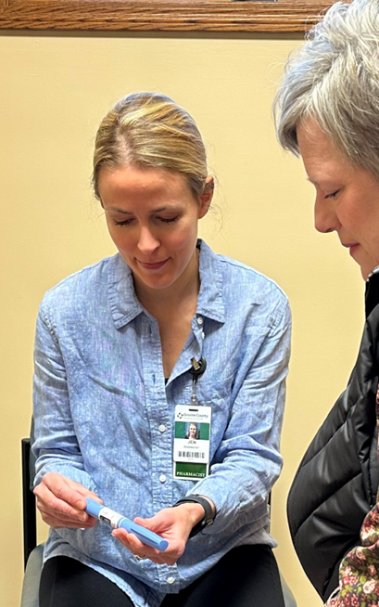
Disease State management
Comprehensive Medication Review
Medication Adherence
Pharmacist
Cost Containment
Preventative Care

Slide 20
Diabetes Management
Set an appropriate A1C target | Recommend an A1C <7% (ADA) in many patients with diabetes to reduce complications. Select less stringent targets, such as A1C <8%(ADA) in certain diabetes patients, such as those at risk for severe hypoglycemia, with limited life expectancy, or with advanced vascular complications. Consider a more stringent target if it can be attained safely and benefits are likely to be realized (e.g., long life expectancy, short diabetes duration, few vascular complications).
Choose the most appropriate agents to achieve the A1C target | Individualize treatment choice based on weight, A1C target, comorbidities, safety, tolerability, and cost In patients with CV disease, heart failure, or kidney disease use an agent with proven cardio-renal benefit
Prevent and manage diabetes complications | Neuropathic pain Foot infections Cardiovascular disease Renal disease
Address diet, exercise, and other lifestyle changes | Consider weight loss of at least 5% to 15% Physical activity Nutrition Nicotine cessation

Slide 21

Medication Adherence Issues
Complex Medication Regimens
Lack of Engagement
Impaired Cognition
Limited Coordination of Care among Multiple Providers
High Cost of Meds
Unclear Medication Directions

Slide 22
Preventative Care
Immunization Screening
Foot Care Education
Screening for ASCVD
Blood Pressure Monitoring
Nicotine Cessation
Sleep Health
Lifestyle Behavior Changes

Slide 23
Cost Containment
Insurance Formularies
Copay Cards and Patient Assistance Programs
Prior Authorizations
Copays and Deductibles

Slide 24
Comprehensive Medication Review
Patient is taking an unnecessary medication | Duplicate Therapy No indication for drug Drug is being used to treat a preventable side effect
Needed medication has not been prescribed | Preventive therapy is needed A current condition is untreated or undertreated
Medication is ineffective | Dose is too low Frequency of dosing is inadequate Drug is inappropriate or not best option Non-adherence
Medication is causing a side effect or toxicity | Dose is too high Allergic reaction Dose change made too quickly Drug–Drug interaction
Patient is not taking medication appropriately | Not taking med as directed Med is not affordable Med regimen is too complex

Slide 25
Inhaled Medications for COPD
The goals of COPD treatment are to reduce symptoms and to decrease the risk and severity of future exacerbations.
  Choice of inhalation device depends on availability, cost, and the patient (e.g., preference, ability to operate the devices properly).
  Nebulizers may be easier to use in sicker patients.
  Appropriate instruction on inhalation technique is very important. Technique should always be assessed prior to determining efficacy of therapy.
Notes:
<number>

Slide 26
Goal: START patient on the right inhalers based on disease severity
2023 GOLD guidelines: Updated assessment tool from ABCD to the ABE assessment tool.
Ensure all patients get a short-acting (rescue) bronchodilator, used as needed (e.g., SABA: albuterol, SAMA: ipratropium).
Combine agents from different classes for more benefit and better tolerability.
SABAs are still effective for episodic symptoms in patients already using a LABA.
Abbreviations: ICS = inhaled corticosteroid; LABA = long-acting beta-2 agonist; LAMA = long-acting muscarinic-antagonist; SABA =short-acting beta-2 agonist; SAMA = short-acting muscarinic antagonist.

Slide 27
Group A: Patients with COPD Assessment Test (CAT) score <10, with ≤1 exacerbation
(not leading to COPD-related hospitalization)
  Provide a short- or long-acting bronchodilator (e.g., albuterol, salmeterol, tiotropium).
    A long-acting bronchodilator (“controller”) is preferred (e.g., aclidinium, glycopyrrolate, tiotropium, umeclidinium), if availability and cost are not barriers, unless symptoms are very occasional.
      LAMAs have a greater effect on reducing exacerbations and hospitalizations compared to LABAs.
      Short-acting bronchodilators, scheduled or as needed, have not been shown to reduce exacerbations (e.g., albuterol, albuterol/ipratropium, ipratropium).

Slide 28
Group B: Patients with CAT score ≥10,
with ≤1 exacerbation
(not leading to COPD-related hospitalization)
Ensure patients are on two long-acting bronchodilators (a LABA [e.g., salmeterol] and a LAMA [e.g., tiotropium]). A combo inhaler may be more convenient and more effective compared to multiple inhalers.
  If a LABA/LAMA combo is not an option due to cost, availability, ADR, either can be used alone.

Slide 29
Group E: Patients with ≥2 exacerbations or ≥1 COPD-related hospitalization per year
Ensure patients are on TWO long-acting medications.
  LABA/LAMA combination has the highest reduction of exacerbations.
  Two long-acting bronchodilators (e.g., LABA/LAMA) are preferred over a LABA with an ICS due to a reduced risk of exacerbations with LABA/LAMA and increased risk for pneumonia with ICS use.
  Consider ADDING an ICS in patients with elevated eosinophil counts.
    LABA/ICS has been shown to be inferior to LABA/LAMA/ICS. Consider LABA/LAMA/ICS for hospitalized, adherent patients to reduce the risk of moderate to severe exacerbations compared to dual therapy, especially if eosinophils counts are 100 cells/mcL (0.1 x 10⁹ cells/L).
    ICS should be added in patients with asthma symptoms.
    ICS may not be beneficial if baseline eosinophil counts are <about 100 cells/mcL.
    Don’t use eosinophil counts to determine when to stop ICS. Discontinue ICS if improvement is not seen after added, due to increased risk of pneumonia with use and a lack of harm with discontinuation (ICS can be stopped abruptly; no need to taper).

Slide 30
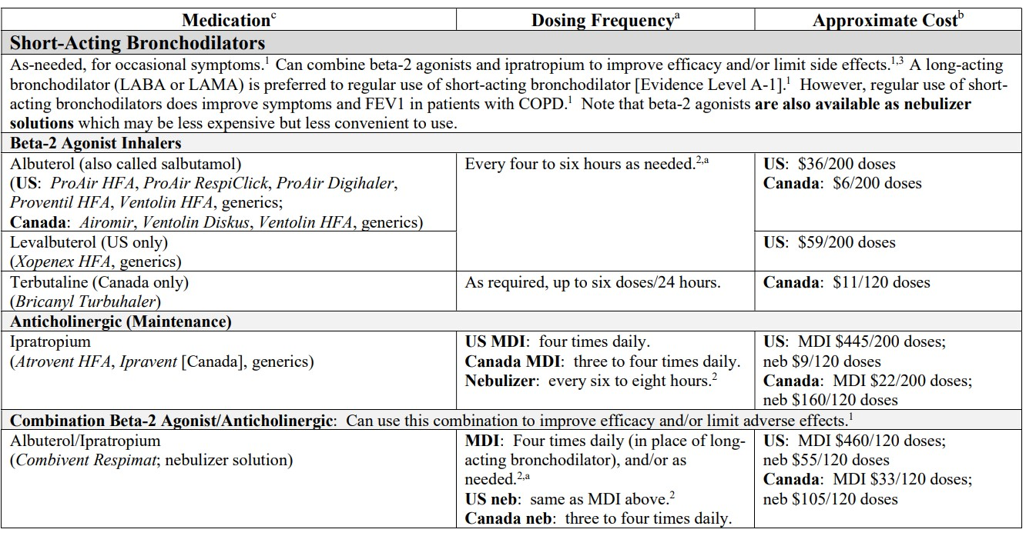
Short-Acting Bronchodilators

Slide 31
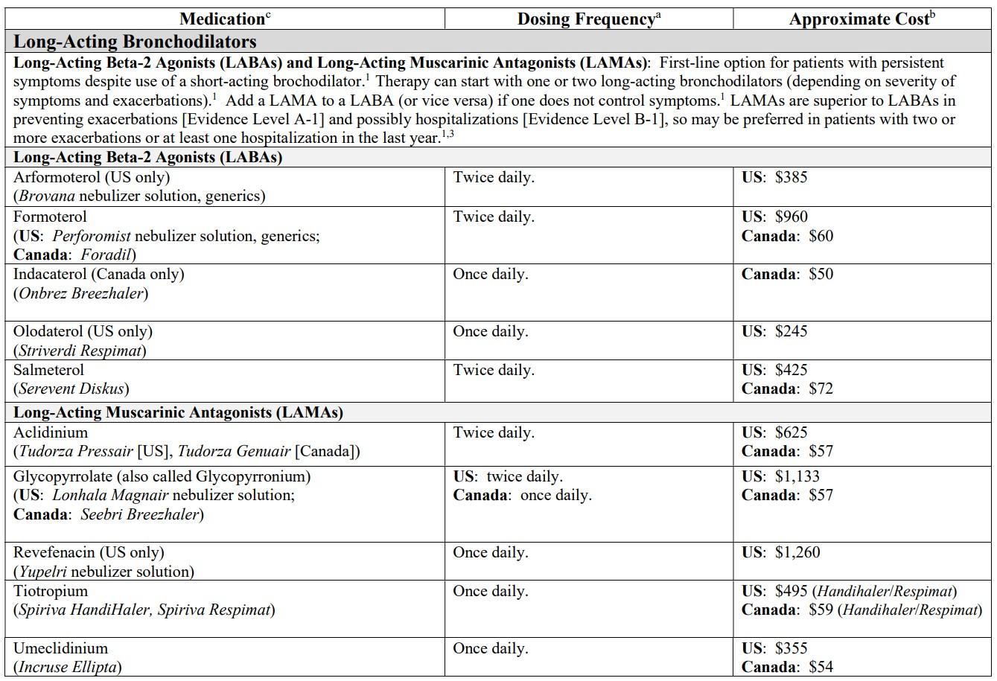
Long-Acting Bronchodilators

Slide 32
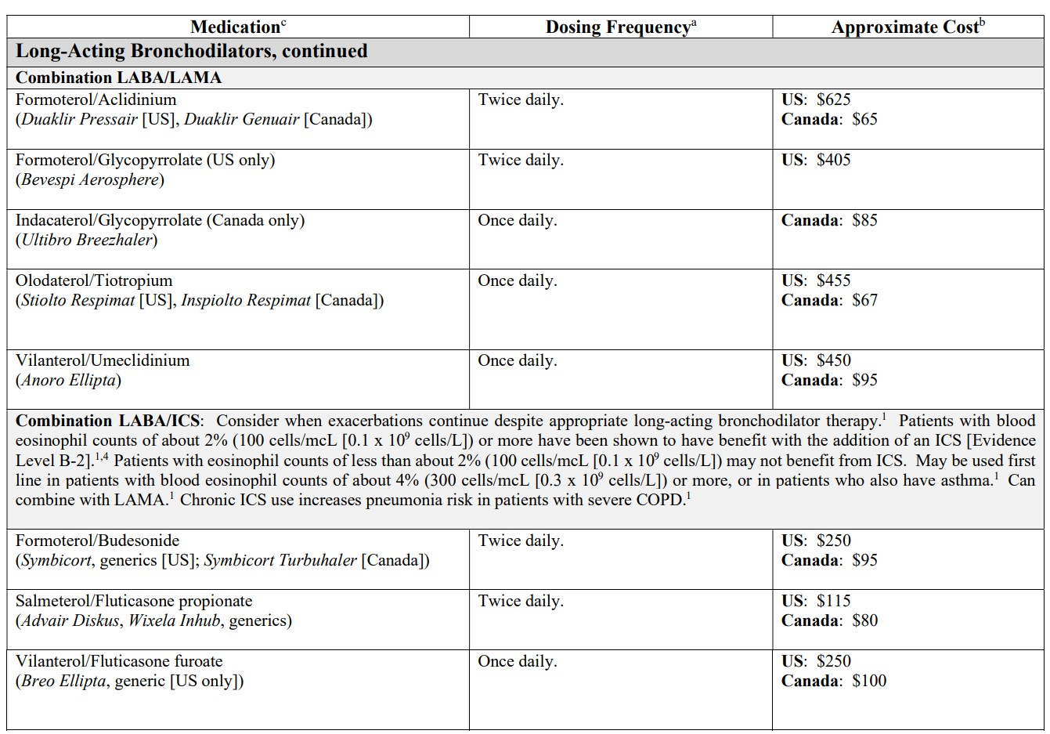
Long-Acting Bronchodilators

Slide 33
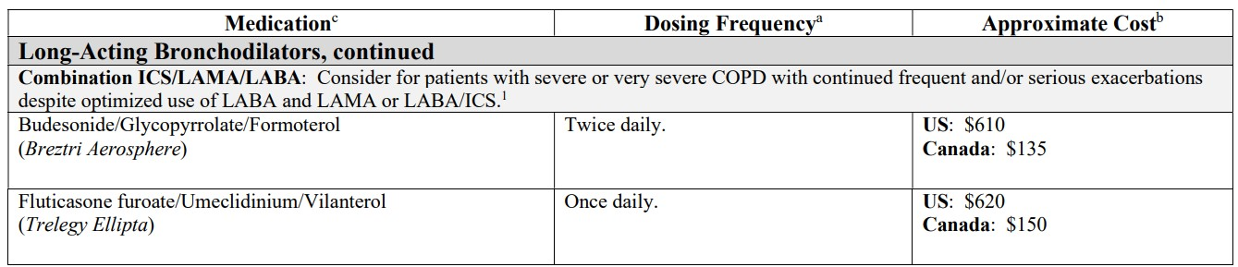
Long-Acting Bronchodilators
Abbreviations: COPD = chronic obstructive pulmonary disease; HFA = hydrofluoroalkane; ICS = inhaled corticosteroid; LABA = long-acting beta-2 agonist; LAMA = long-acting muscarinic antagonist (or anticholinergic); MDI = metered-dose inhaler; Neb = nebulizer solution.
a. US product labeling used within this resource: Advair Diskus (August 2020), Anoro Ellipta (August 2020), Atrovent HFA (February 2020),
Bevespi Aerosphere (May 2019), Breo Ellipta (January 2019), Breztri Aerosphere (July 2020), Brovana (May 2019), Combivent Respimat
(December 2021), Duaklir Pressair (March 2019), Incruse Ellipta (June 2019), Lonhala Magnair (August 2020), Perforomist (May 2019),
Serevent Diskus (December 2018), Spiriva Handihaler (November 2021), Spiriva Respimat (November 2021), Stiolto Respimat (November
2021), Striverdi Respimat (November 2021), Symbicort (December 2017), Trelegy Ellipta (May 2022), Tudorza Pressair (April 2019), Yupelri
(November 2021).
Canadian product labeling used within this resource: Advair Diskus (June 2020), Airomir (December 2020), Anoro Ellipta (August 2017),
Atrovent HFA (November 2019), Breztri Aerosphere (July 2021), Breo Ellipta (January 2019), Bricanyl Turbuhaler (June 2021), Combivent
Respimat (November 2019), Duaklir Genuair (September 2022), Foradil (July 2021), Incruse Ellipta (September 2020), Inspiolto Respimat
(November 2019), ipratropium nebulizer solution (Teva, February 2022), Onbrez Breezhaler (March 2021), Seebri Breezhaler (September
2016), Serevent Diskus (March 2021), Spiriva Handihaler (April 2022), Spiriva Respimat (May 2019), Striverdi Respimat (May 2019),
Symbicort Turbuhaler (February 2021), Trelegy Ellipta (January 2022), Tudorza Genuair (September 2022), Ultibro Breezhaler (January
2020).
b. Pricing based on wholesale acquisition cost (WAC) for an MDI or 30-day supply of highest strength of generic if available. US medication
pricing by Elsevier, accessed October 2022.
c. The only long-acting inhalation therapies included are FDA- or Health Canada-approved for treatment of COPD. Not all available strengths
are approved for treatment of COPD; check product labeling for approved strengths/dosing.
Clinical Resource, Improving COPD Care. Pharmacist’s Letter/Pharmacy Technician’s Letter/Prescriber’s Letter. March 2023. [390305]
Clinical Resource, Inhaled Medications for COPD. Pharmacist’s Letter/Prescriber’s Letter. November 2022. [381116]

Slide 34
Goals for COPD Care
Prevent and treat influenza and COVID-19, prevent pneumonia
Smoking cessation
Educate about COPD
Correct inhalers for disease severity
Understand how to use inhalers
Medication adherence
Identify need for treatment modification or additional COPD meds
Control chronic comorbidities
Empower patients for self-care
Prevent avoidable hospital readmissions

