Slide 1

Reimbursement 2022
cardiac
Susan Bauman, BSN, CCRP
Reimbursement Chairperson-Cardiac
susan.bauman@nwhealthin.com

Slide 2
No disclosures.

Slide 3
Emergency PHE
Just extended through July, 2022
Virtual direct supervision scheduled to expire Dec 31, 2022 (86 FR 65248)
Virtual delivery of CR/PR scheduled to cease being allowed when PHE ends (86 FR 63747)

Slide 4
E/M billing code - new 2022 regulation
Evaluation and Management (E/M) service code
A Physician billing code, or “professional” code
Can be applied in connection with establishing & signing the initial ITP or
day one of rehab
All E/M billing requirements need to be met
NOT billable by the rehab department
86 FR 65245

Slide 5
NPPs (non physician practitioners)
Currently cannot order or supervise CR/ICR/PR
Will be allowed to order & supervise CR/ICR/PR in January 2024 (per BBA of 2018)

Slide 6
Legislative Action
HR3348 will allow CR/ICR/PR to expand space, move off-campus, improve location, reduce waiting lists, add accessible sites without a severe reduction in Medicare reimbursement.
HR1956/S.1986 will move forward the effective date that NPPs could order & supervise CR/ICR/PR
https://www.aacvpr.org/Take-Action Easily send a support request to your US Representative or both of our US Senators

Slide 7
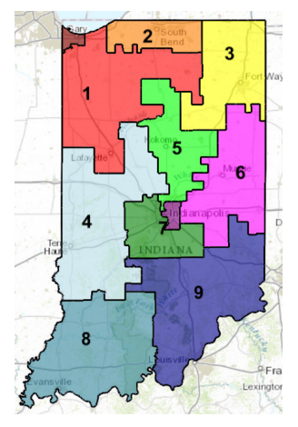
US Representatives- Indiana
1. Representative Mrvan, Frank J. (202) 225-2461
2. Representative Walorski, Jackie (202) 225-3915
3. Representative Banks, Jim (202) 225-4436
4. Representative Baird, James R. (202) 225-5037
5. Representative Spartz, Victoria (202) 225-2276
6. Representative Pence, Greg (202) 225-3021
7. Representative Carson, Andre (202) 225-4011
8. Representative Bucshon, Larry (202) 225-4636
9. Representative Hollingsworth, Trey (202) 225-5315

Slide 8
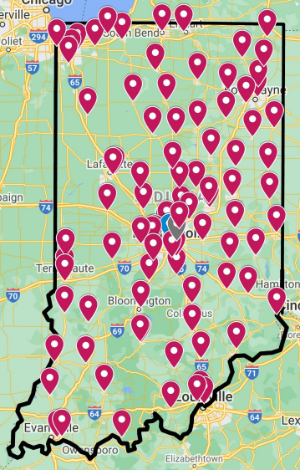
Indiana
CR/PR Programs

Slide 9
CMS Conditions of Coverage
CARDIAC REHAB/ INTENSIVE CARDIAC REHAB
42 CFR 410.49 Code of Federal Regulations
PULMONARY REHAB
42 CFR 410.47 Code of Federal Regulations

Slide 10
Billing 101, Cardiac
Cardiac Rehab
Intensive Cardiac Rehab
CPT Code 93797 Physician Services for outpt CR without continuous ECG monitoring
CPT Code 93798 Physician Services for outpt CR with continuous ECG monitoring
Must have some exercise every day
One session must be > 31min, Two sessions must be > 91min (CR), 2 session max/day
36 weeks to complete maximum of 36 sessions allowed/diagnosis (CR)
CMS has no staffing requirements or staff patient ratios
Phase I (in hospital) is not separately billable to CMS
Phase III/IV/maintenance is not billable to CMS
Medicare Provision for CR 42 CFR 410.49
Intensive CR without exercise G0423
Intensive CR with exercise G0422
Must have some exercise every day
One session must be > 31min, Two sessions must be > 91min (CR)
6 session max/day (ICR)
18 weeks for 72 sessions (ICR)
CMS has no staffing requirements or staff patient ratios
Phase I (in hospital) is not separately billable to CMS
Phase III/IV/maintenance is not billable to CMS
Medicare Provision for CR 42 CFR 410.49

Slide 11
Billing modifiers
KX MODIFIER
Must be used for any CR sessions beyond the first 36 in a patient’s Medicare lifetime
CWF (common working file) counts from zero up with no cap
Modifier 59
Two sessions of CR in one day where one 93798 code & one 93797 code are used
Modifier 59 does NOT apply when: Two sessions of CR in one day where two 93798 codes are used or Two sessions of CR in one day where two 93797 codes are used

Slide 12
SET-PAD THERAPY
Procedure code: CPT 93668 . Limit: One session/day (30-60 minutes)
SET is limited to 72 lifetime sessions under Medicare. A second referral is required for sessions over 36 and/or beyond a 12-week period
CMS counts down # of sessions used (like PR). KX modifier is required after the first 36 sessions are received Supervised Exercise Therapy for PAD
Level of supervision: Direct supervision of a physician, physician assistant, or nurse practitioner/clinical nurse specialist
Must have a face-to-face visit with MD managing PAD treatment to obtain a referral to SET
Two settings covered: hospital outpatient or MD office
Qualifying criterion: presence of claudication symptoms, this includes pre and post surgical interventions
NOT CR, no ITP requirement for MD signature

Slide 13


Slide 14
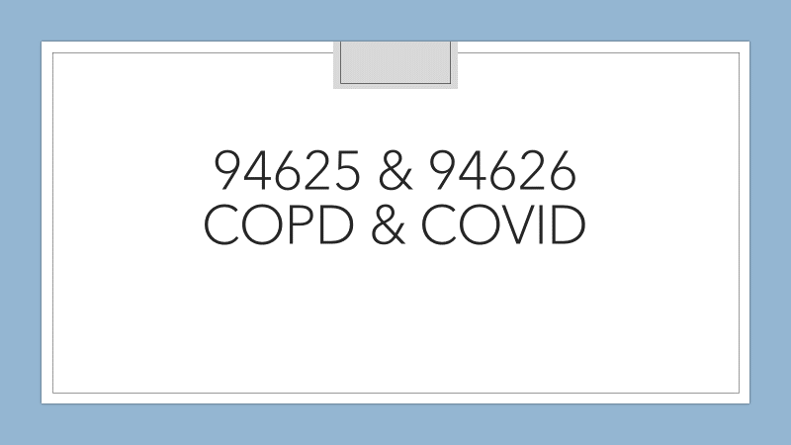

Slide 15
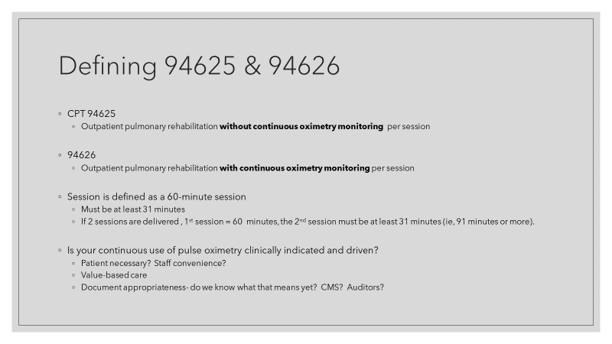

Slide 16
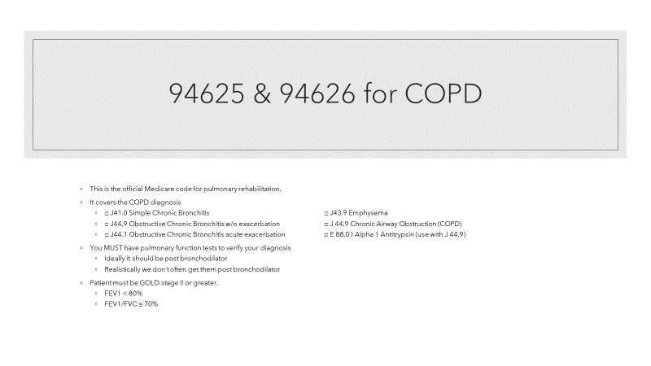

Slide 17
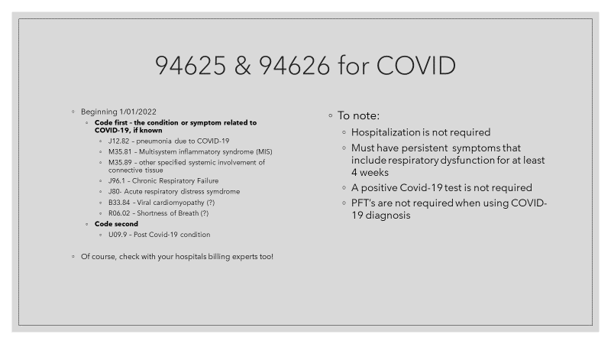

Slide 18
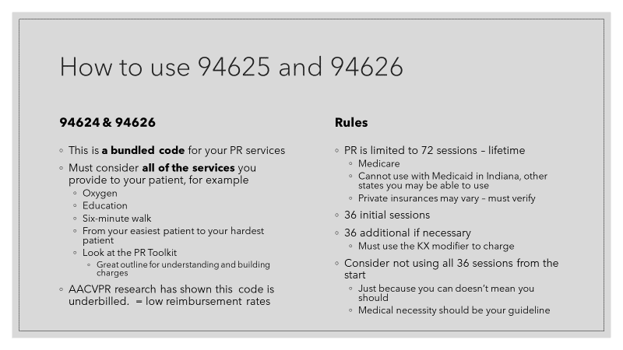

Slide 19
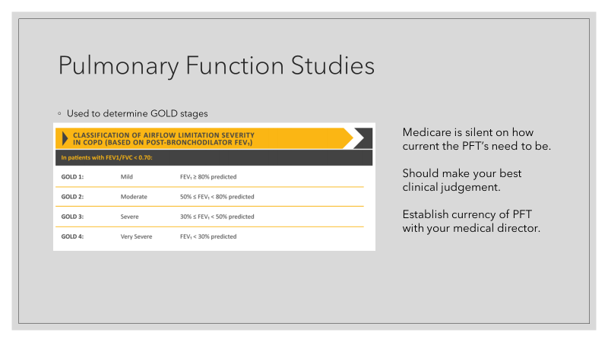

Slide 20
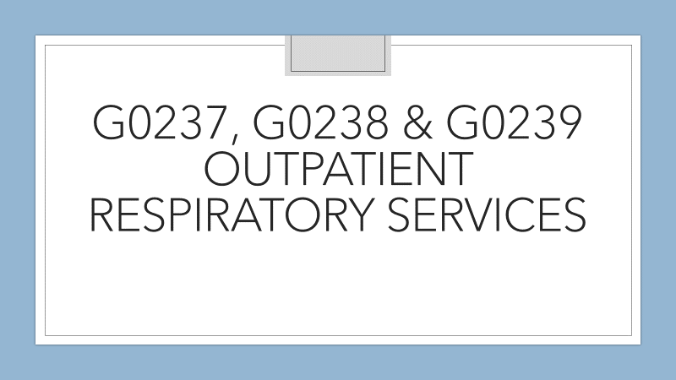

Slide 21
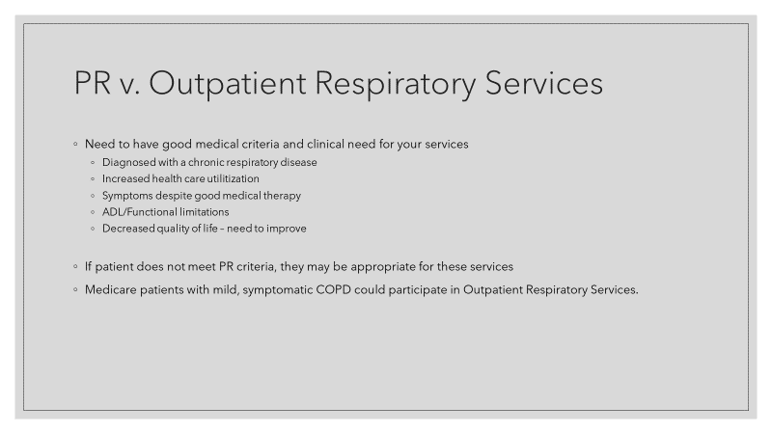

Slide 22
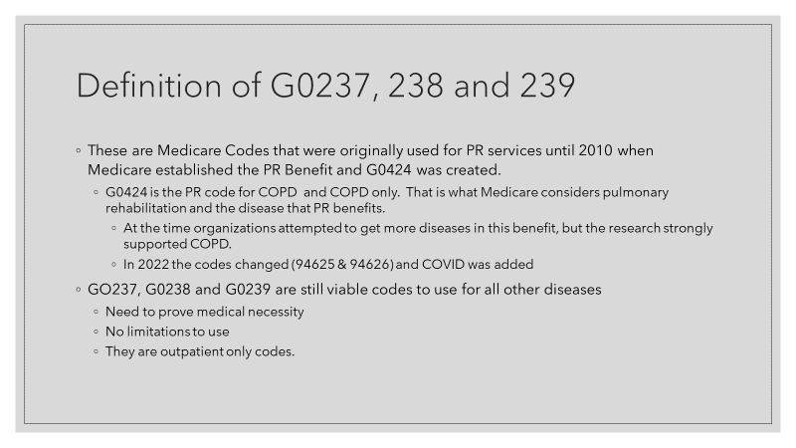

Slide 23
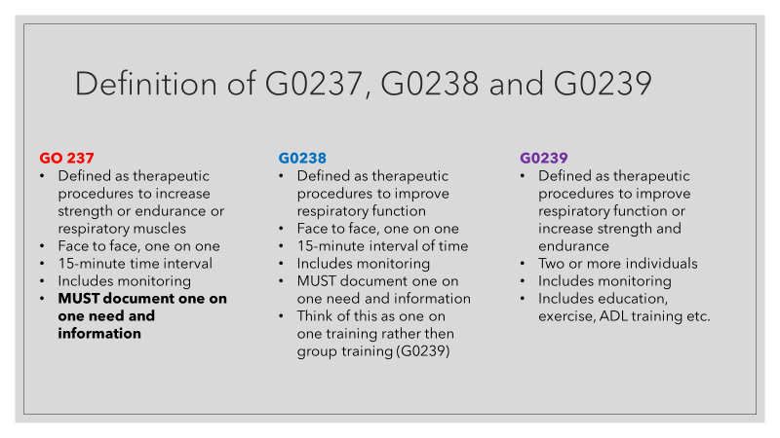

Slide 24
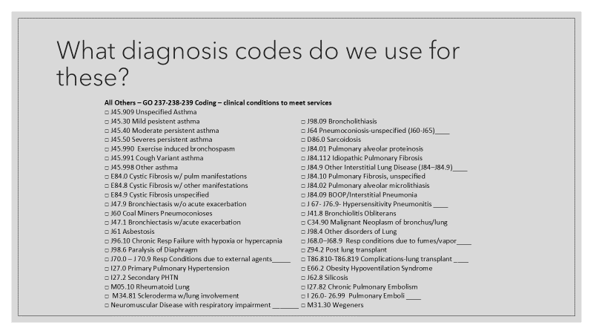

Slide 25
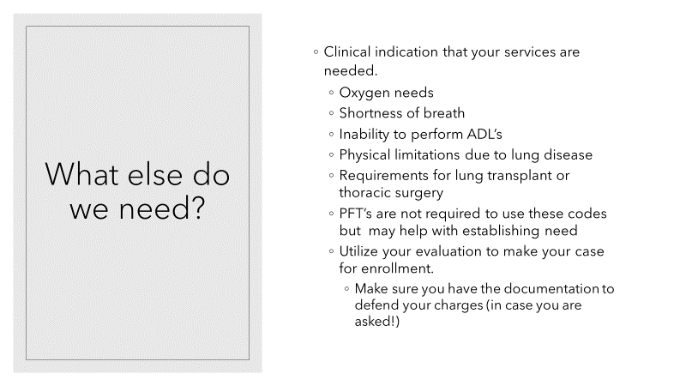

Slide 26
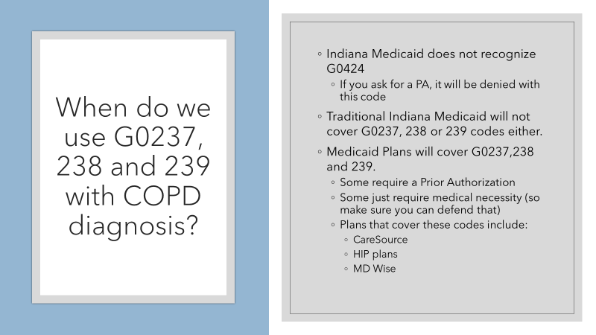

Slide 27
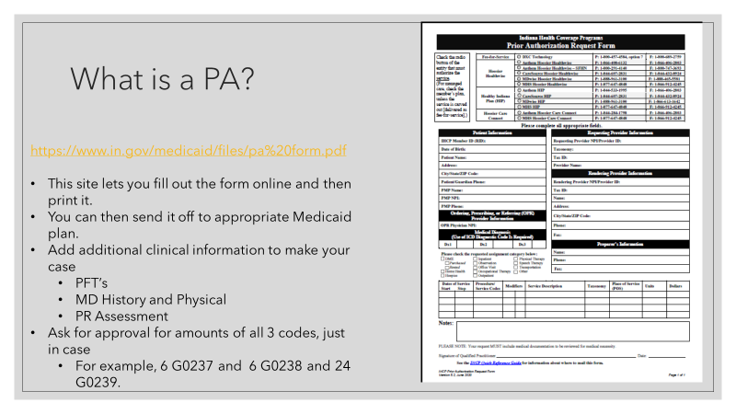

Slide 28

Medicare is great….. but
Traditional Medicare is great for PR
  2022 co-pays per session for PR
    94625/94626 – $11.37
    G0239 - $6.92
    G0237 and G0238 - $ 5.05
Medicare replacement plans often have a high co-pay for PR
  Copays are often $30-40 per session
Medicare supplement plans often do not have a high co-pay
Private Insurers often follow Medicare Rules, so you will need to ask about their co-pays as well.
Notes:
<number>

Slide 29
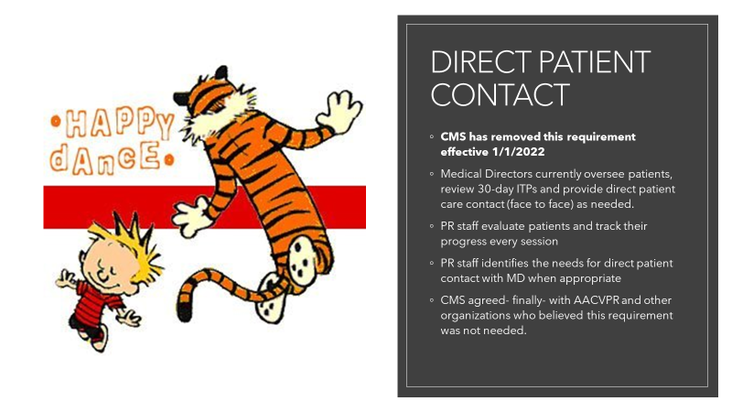

Slide 30
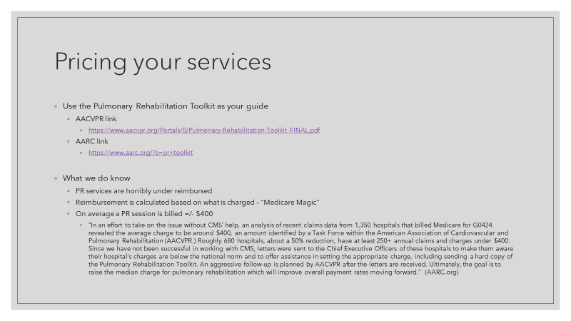

Slide 31
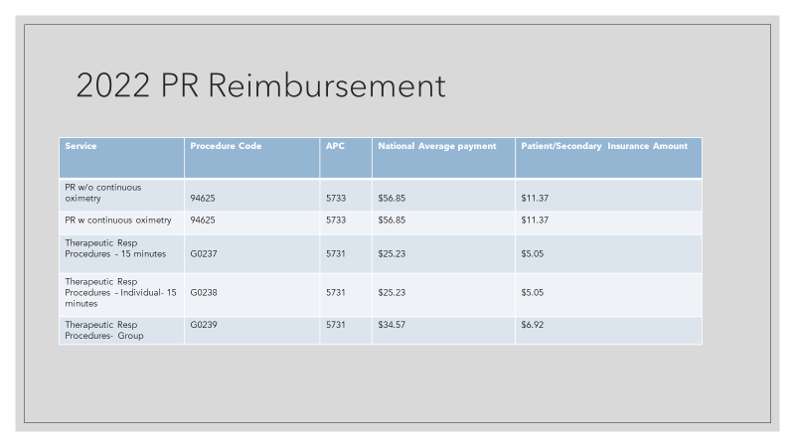

Slide 32
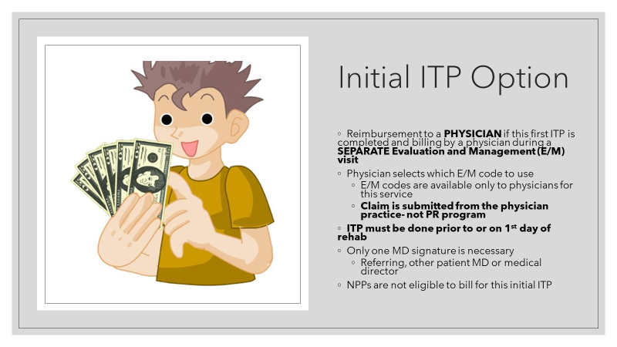

Slide 33


Slide 34
Questions?
Resources available to you:
Susan Bauman, Cardiac Rehab Reimbursement Chairperson susan.Bauman@nwhealthin.com
Debbie Koehl, Pulmonary Rehab Reimbursement Chairperson dkoehl@iuhealth.org
www.iscvpr.org
www.aacvpr.org

Slide 35
